Slide 1
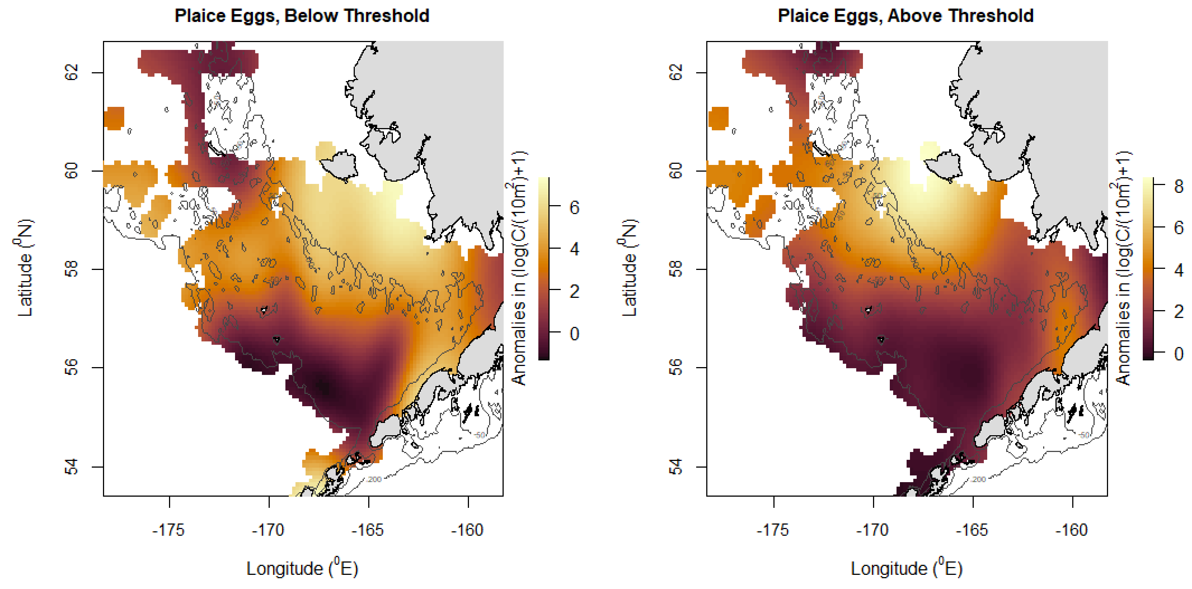
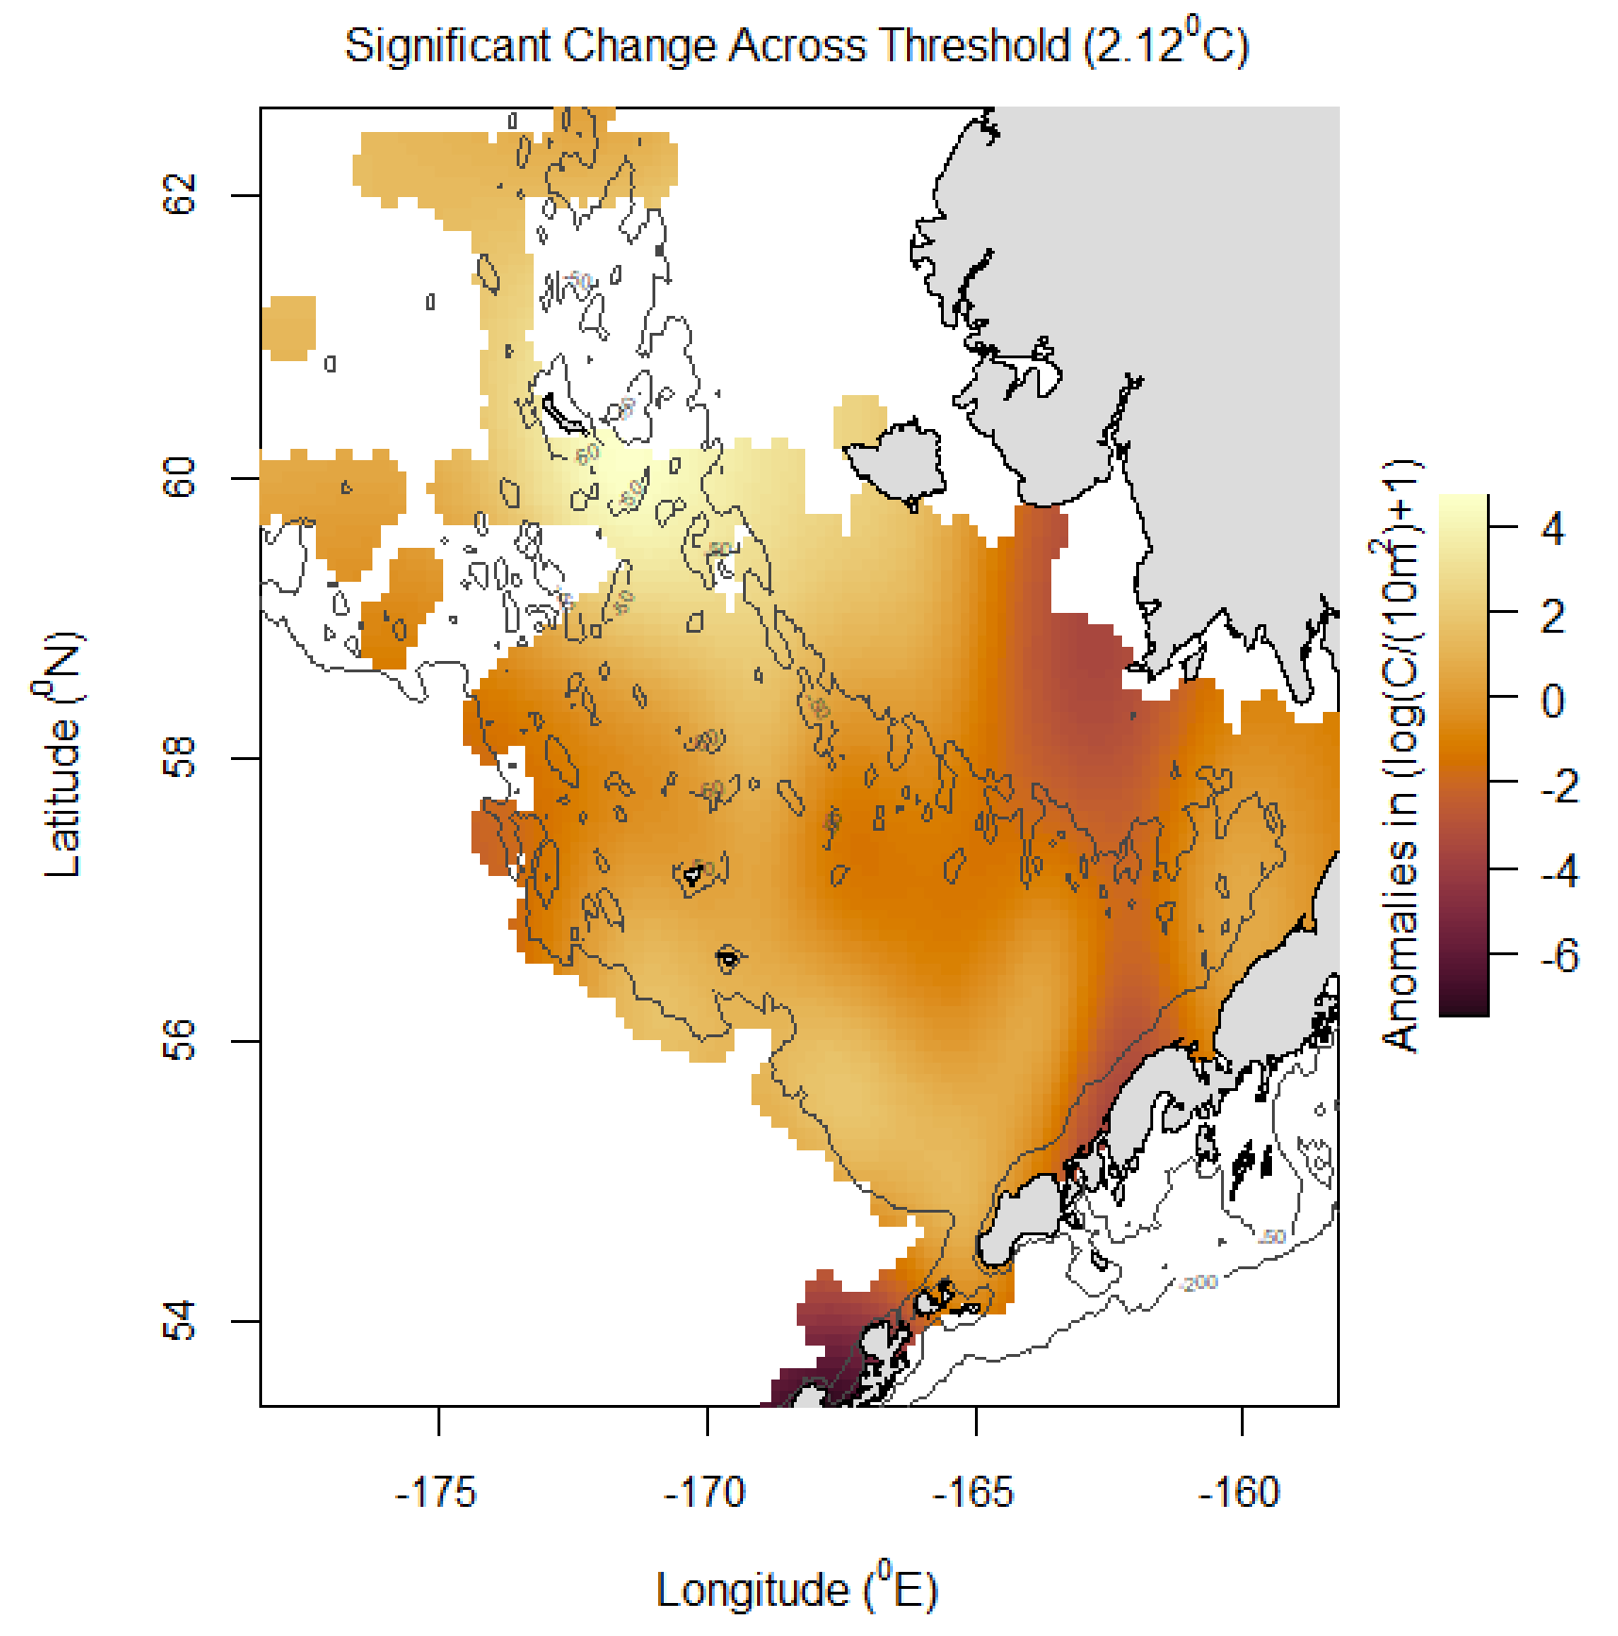
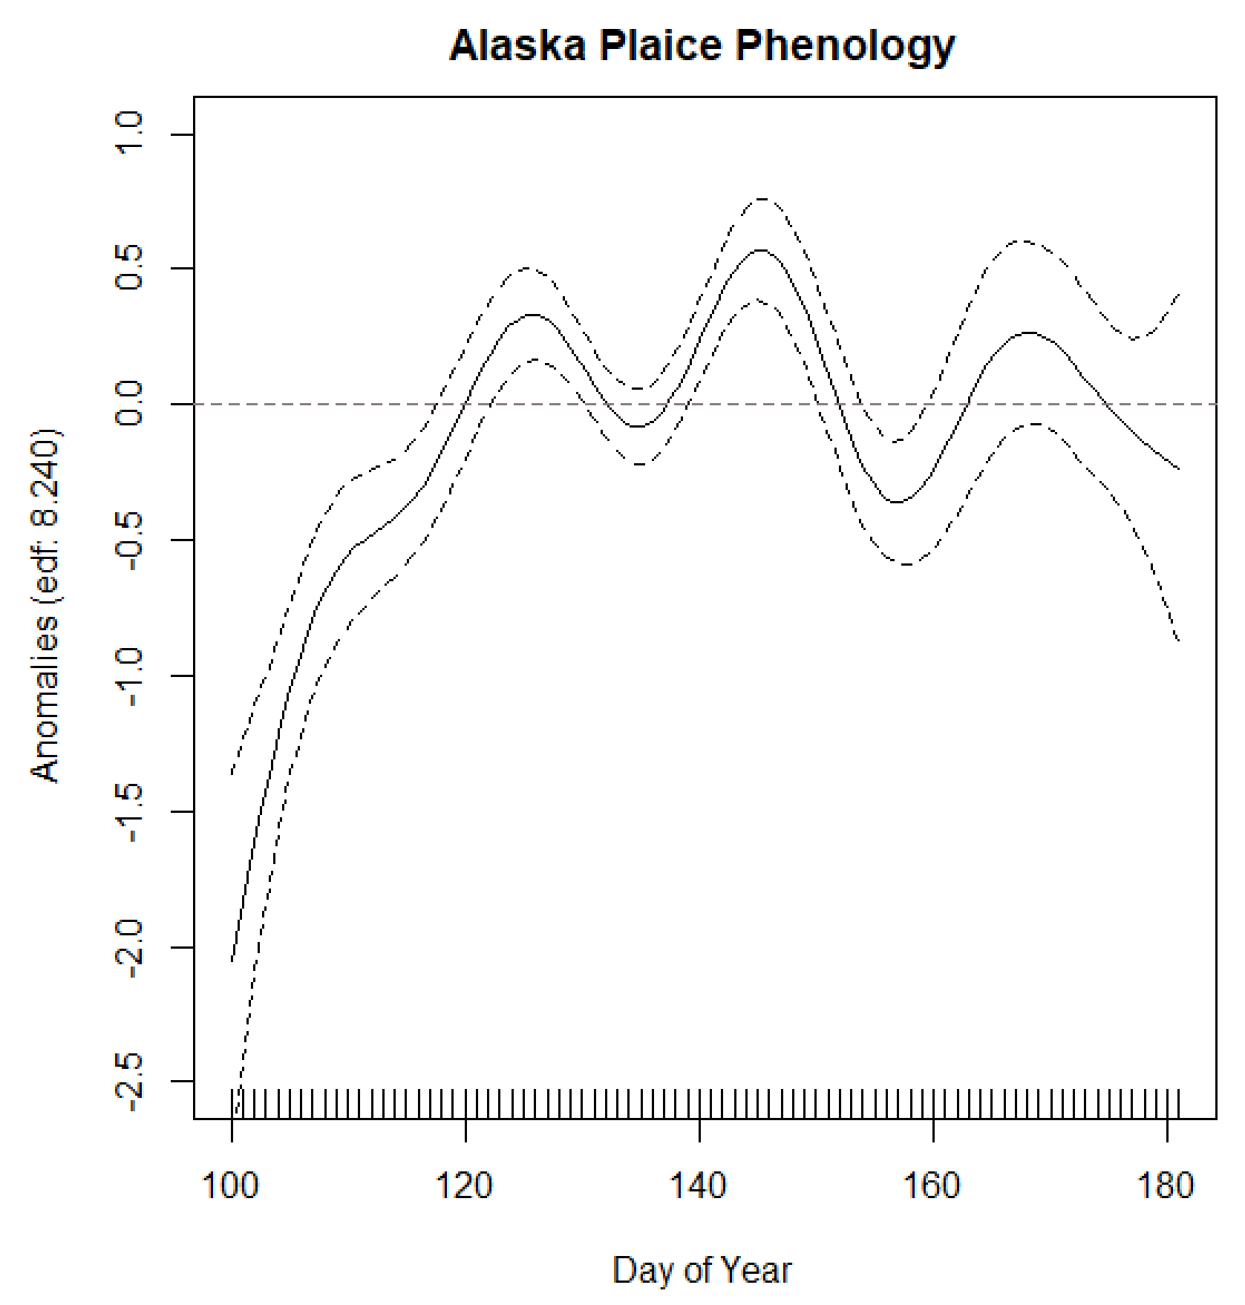
Alaska Plaice – best model: threshold geography (75%), 2d (82.9%). AIC power (thr.geo/eg.base) = 0.97; AIC power (lv.2d/lv.base) = 0.95

Slide 2
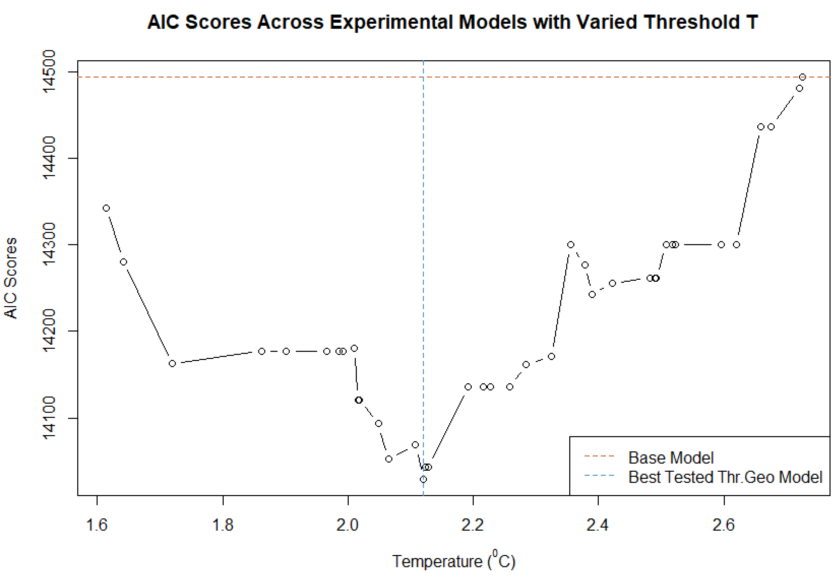
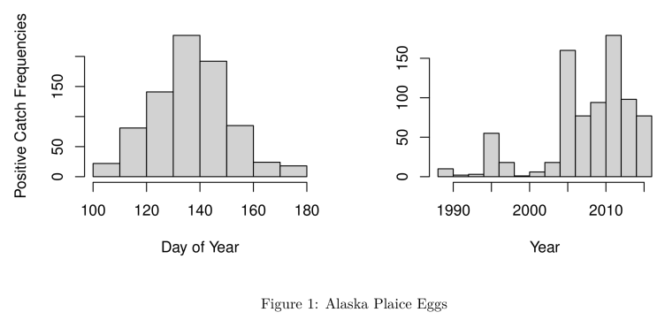
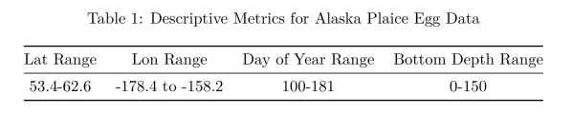
Alaska Plaice – best model: threshold geography (75%), 2d (82.9%). AIC power (thr.geo/eg.base) = 0.97; AIC power (lv.2d/lv.base) = 0.95

Slide 3
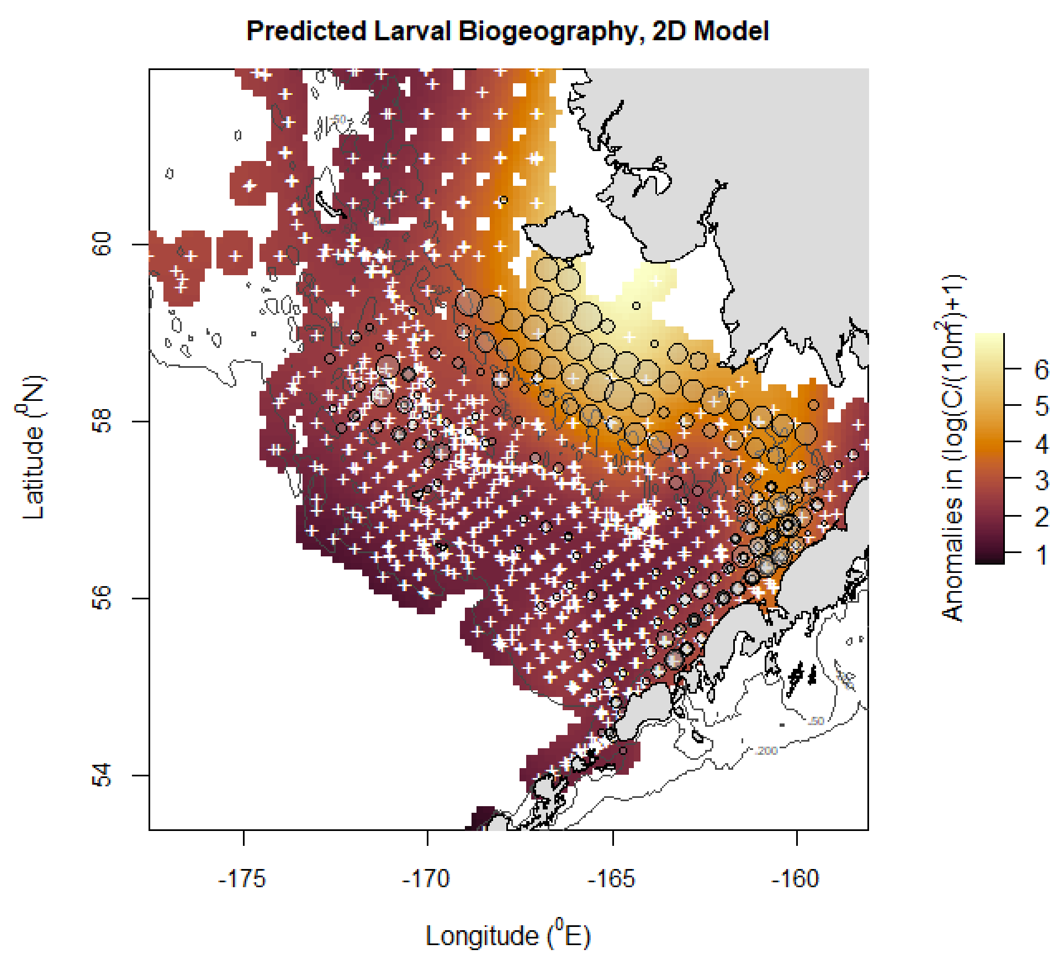
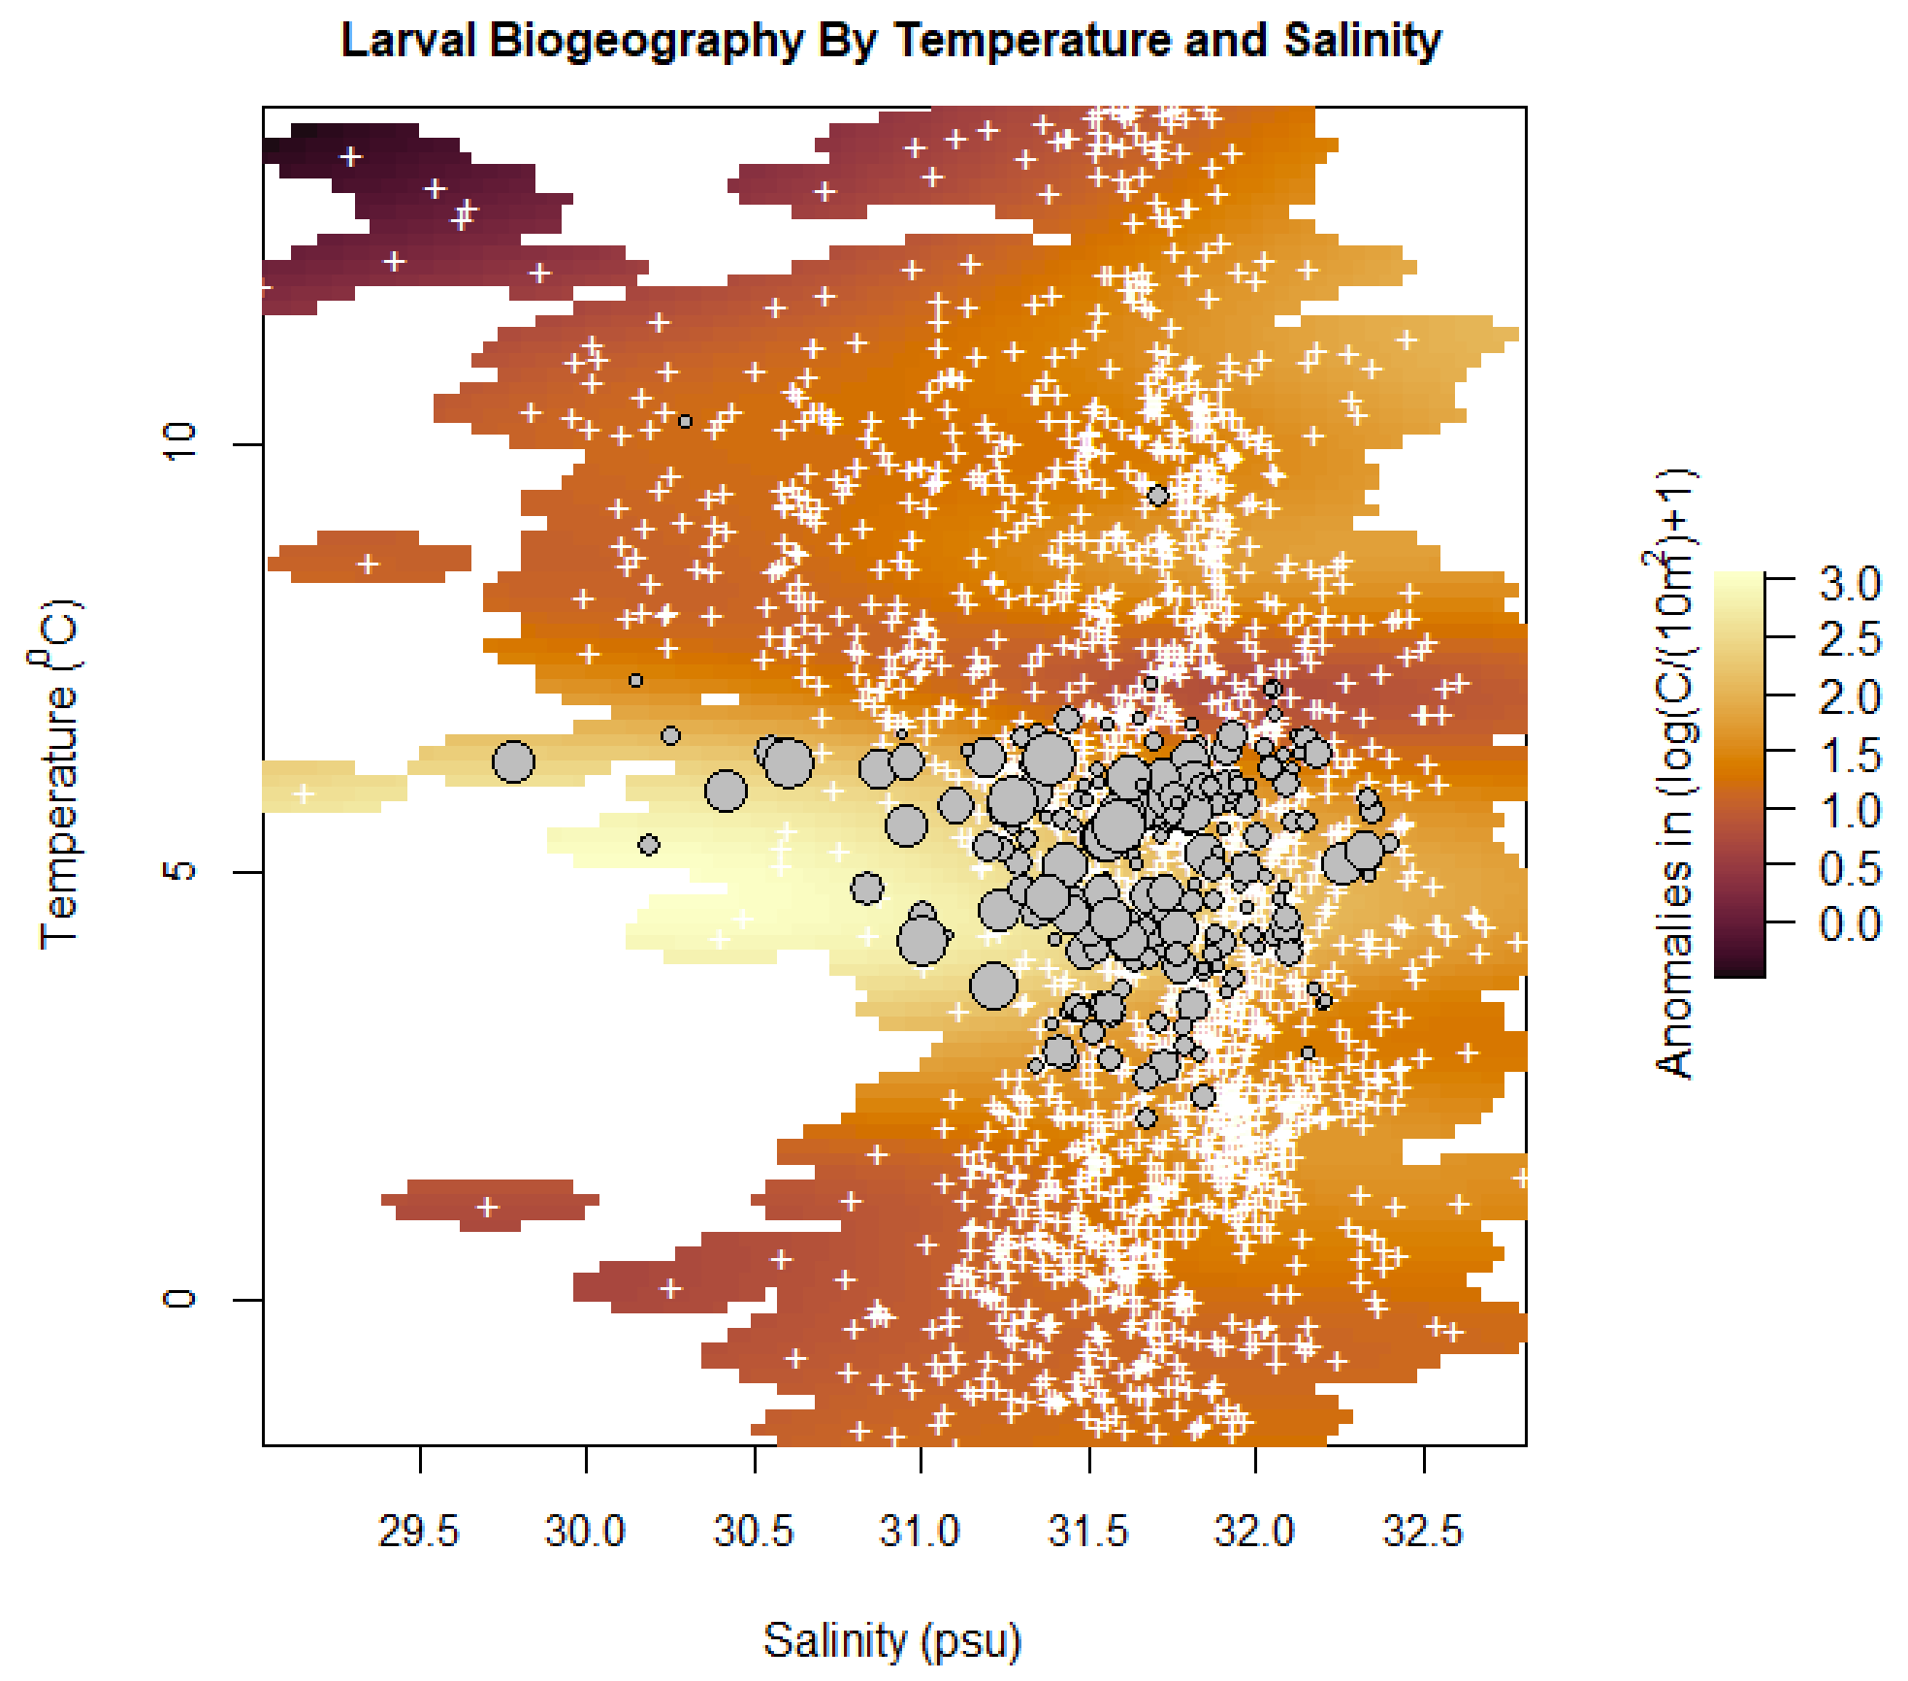
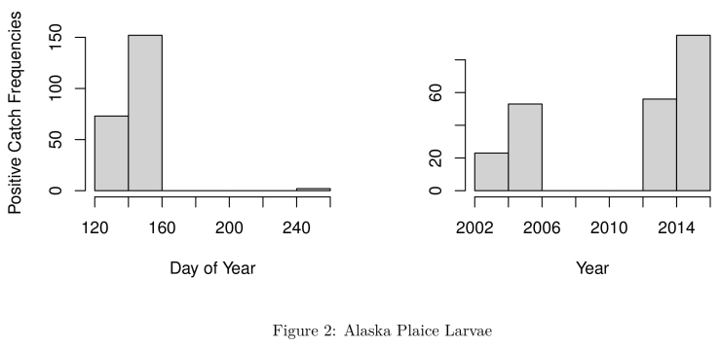
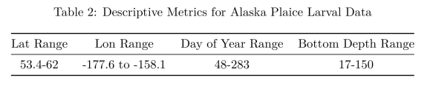
Alaska Plaice – best model: threshold geography (75%), 2d (82.9%). AIC power (thr.geo/eg.base) = 0.97; AIC power (lv.2d/lv.base) = 0.95

Slide 4
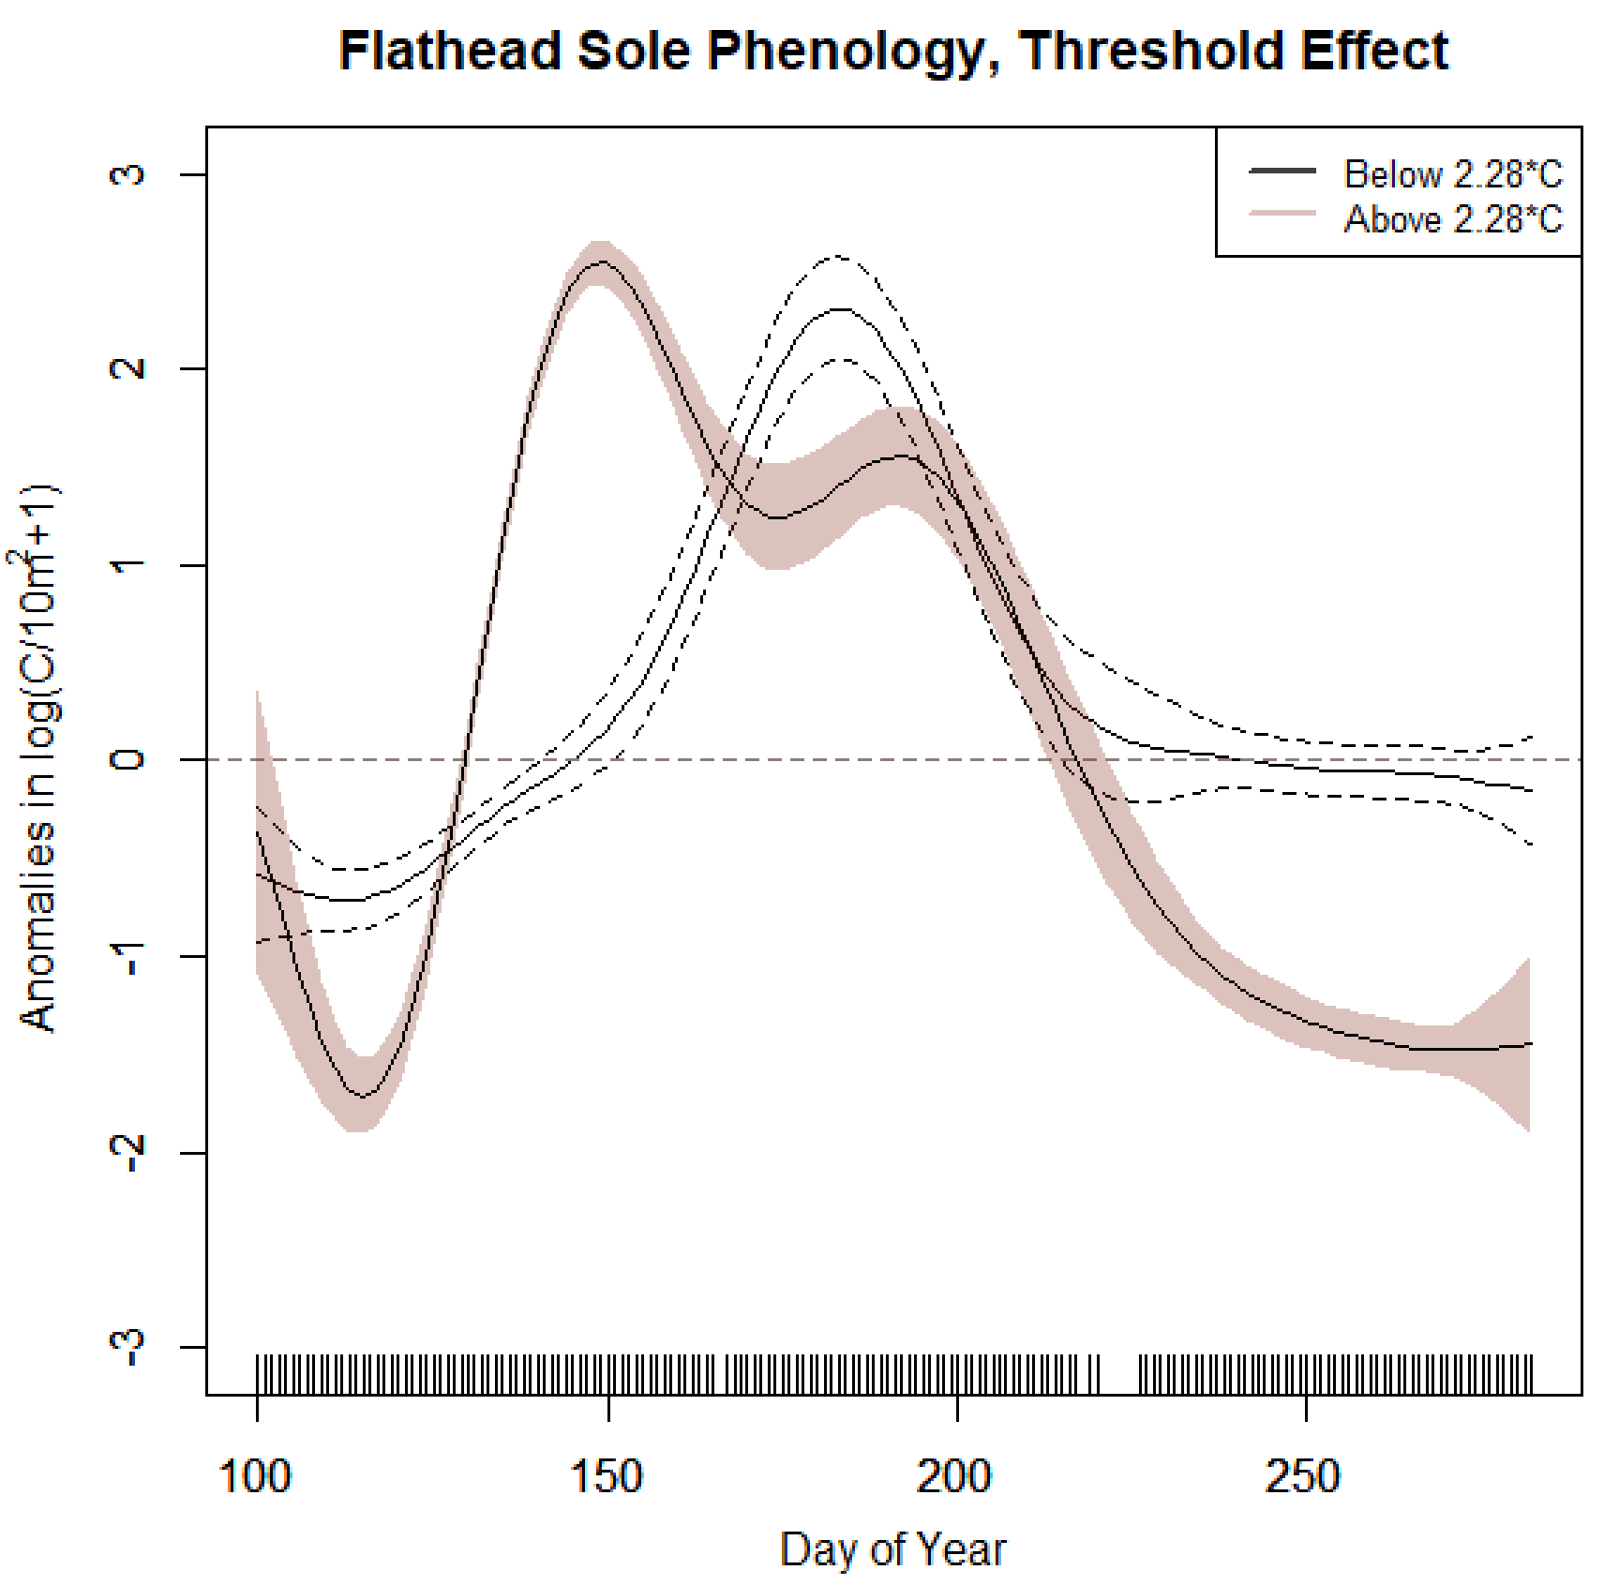
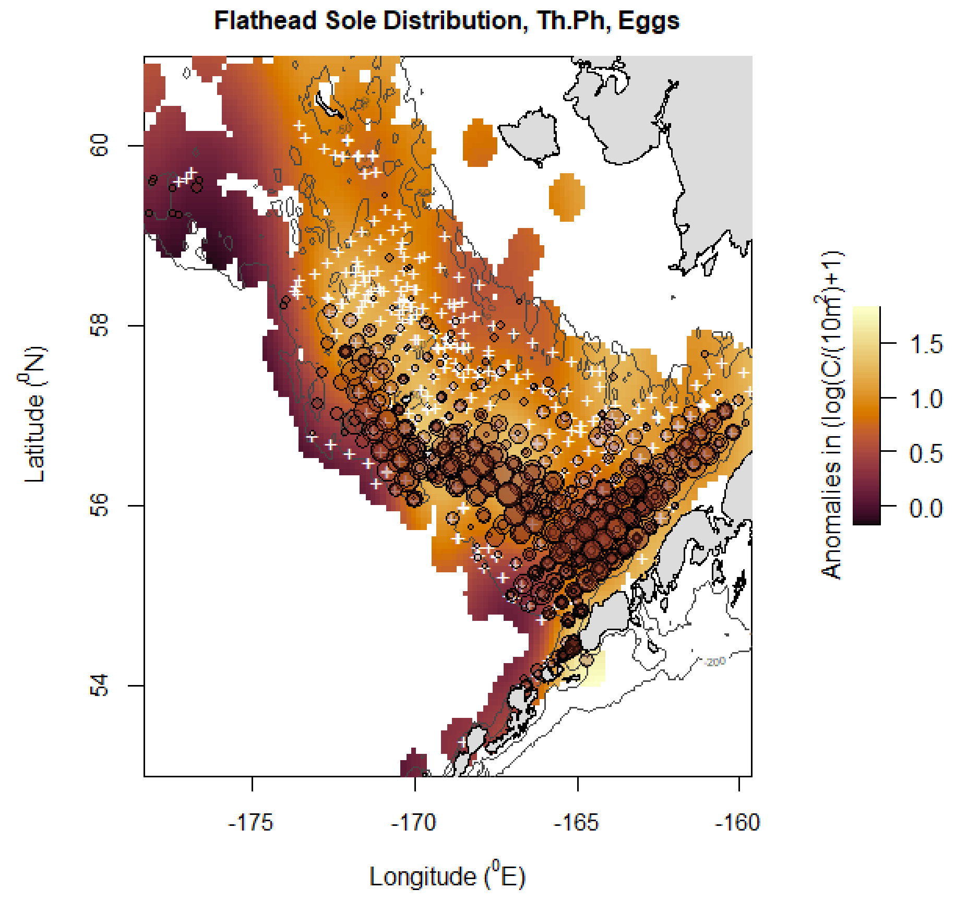
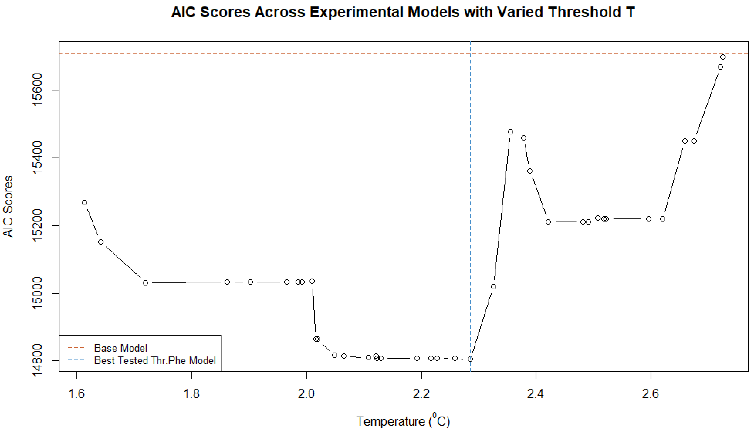
Flathead Sole – best model: threshold phenology (75%), 2d (82.6%). AIC power (thr.phe/eg.base) = 0.94; AIC power (lv.2d/lv.base) = 0.98

Slide 5
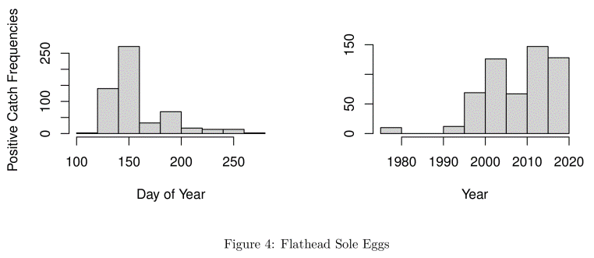
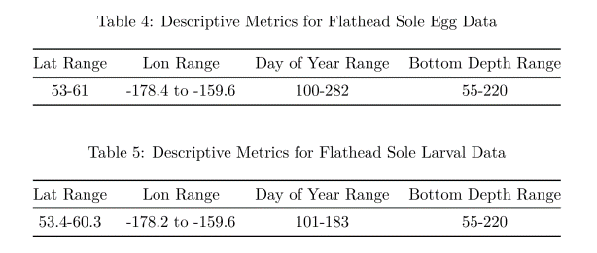
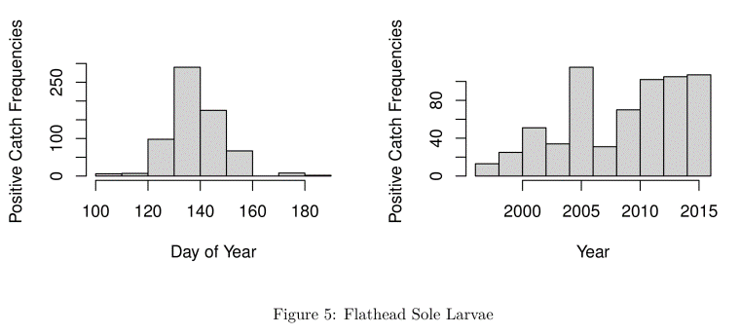
Flathead Sole – best model: threshold phenology (75%), 2d (82.6%). AIC power (thr.phe/eg.base) = 0.94; AIC power (lv.2d/lv.base) = 0.98

Slide 6
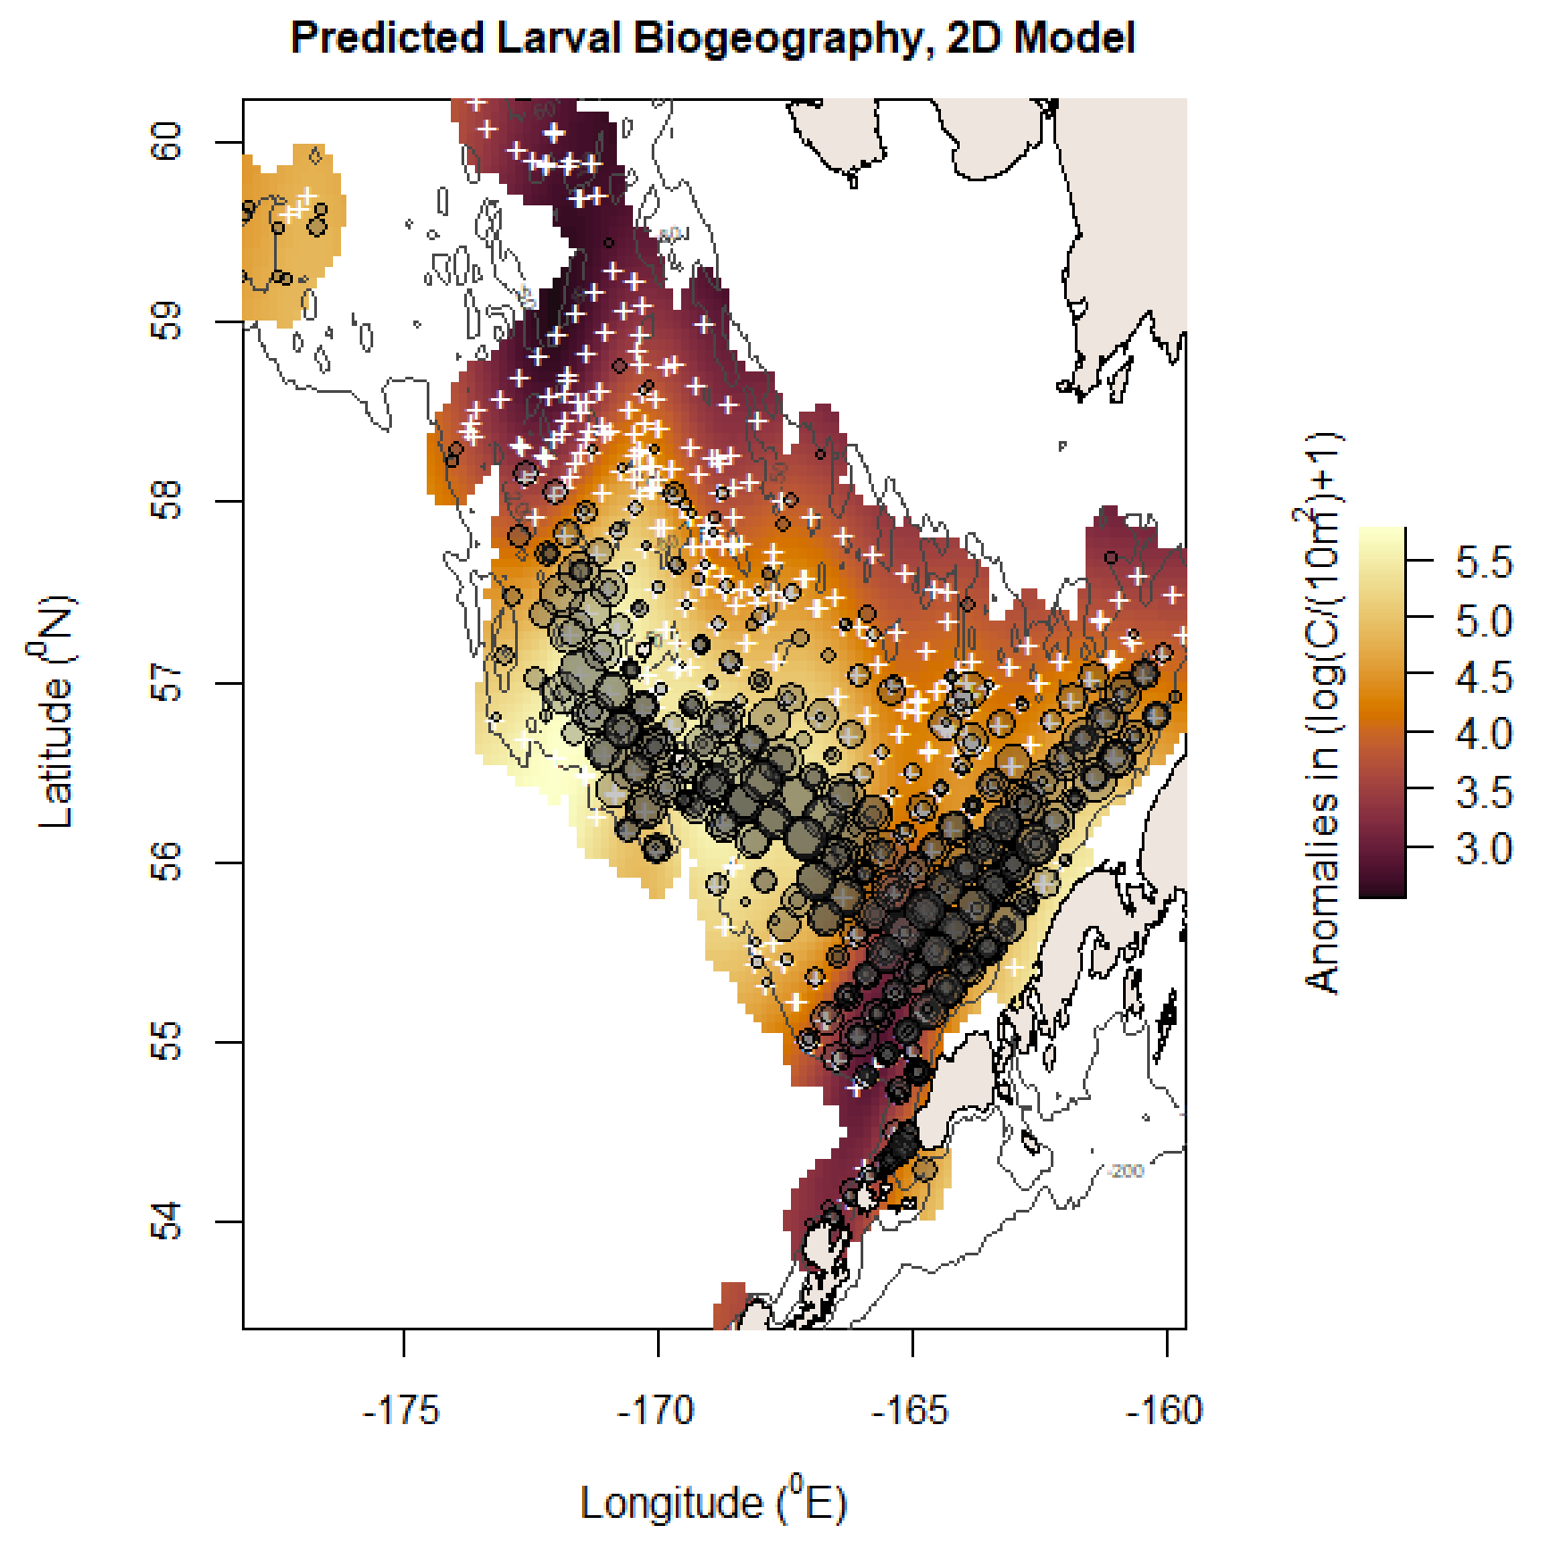
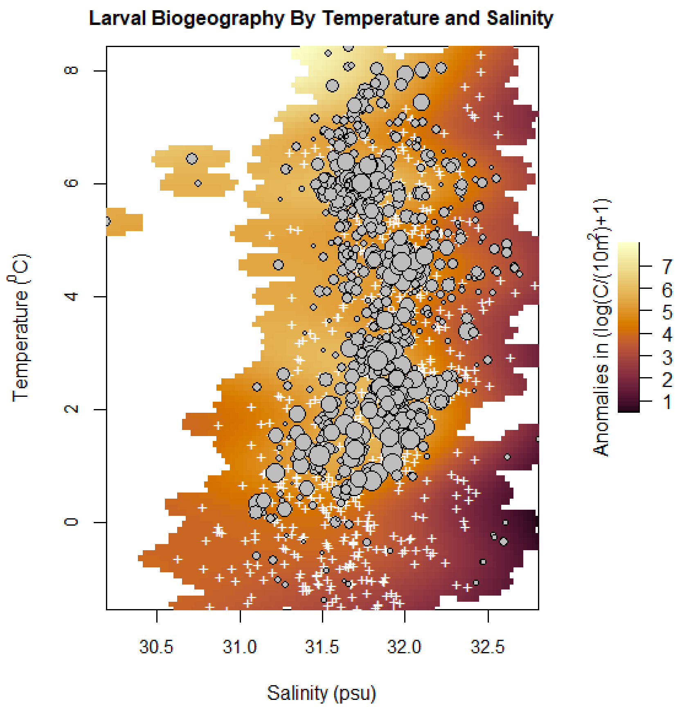
Flathead Sole – best model: threshold phenology (75%), 2d (82.6%). AIC power (thr.phe/eg.base) = 0.94; AIC power (lv.2d/lv.base) = 0.98

Slide 7
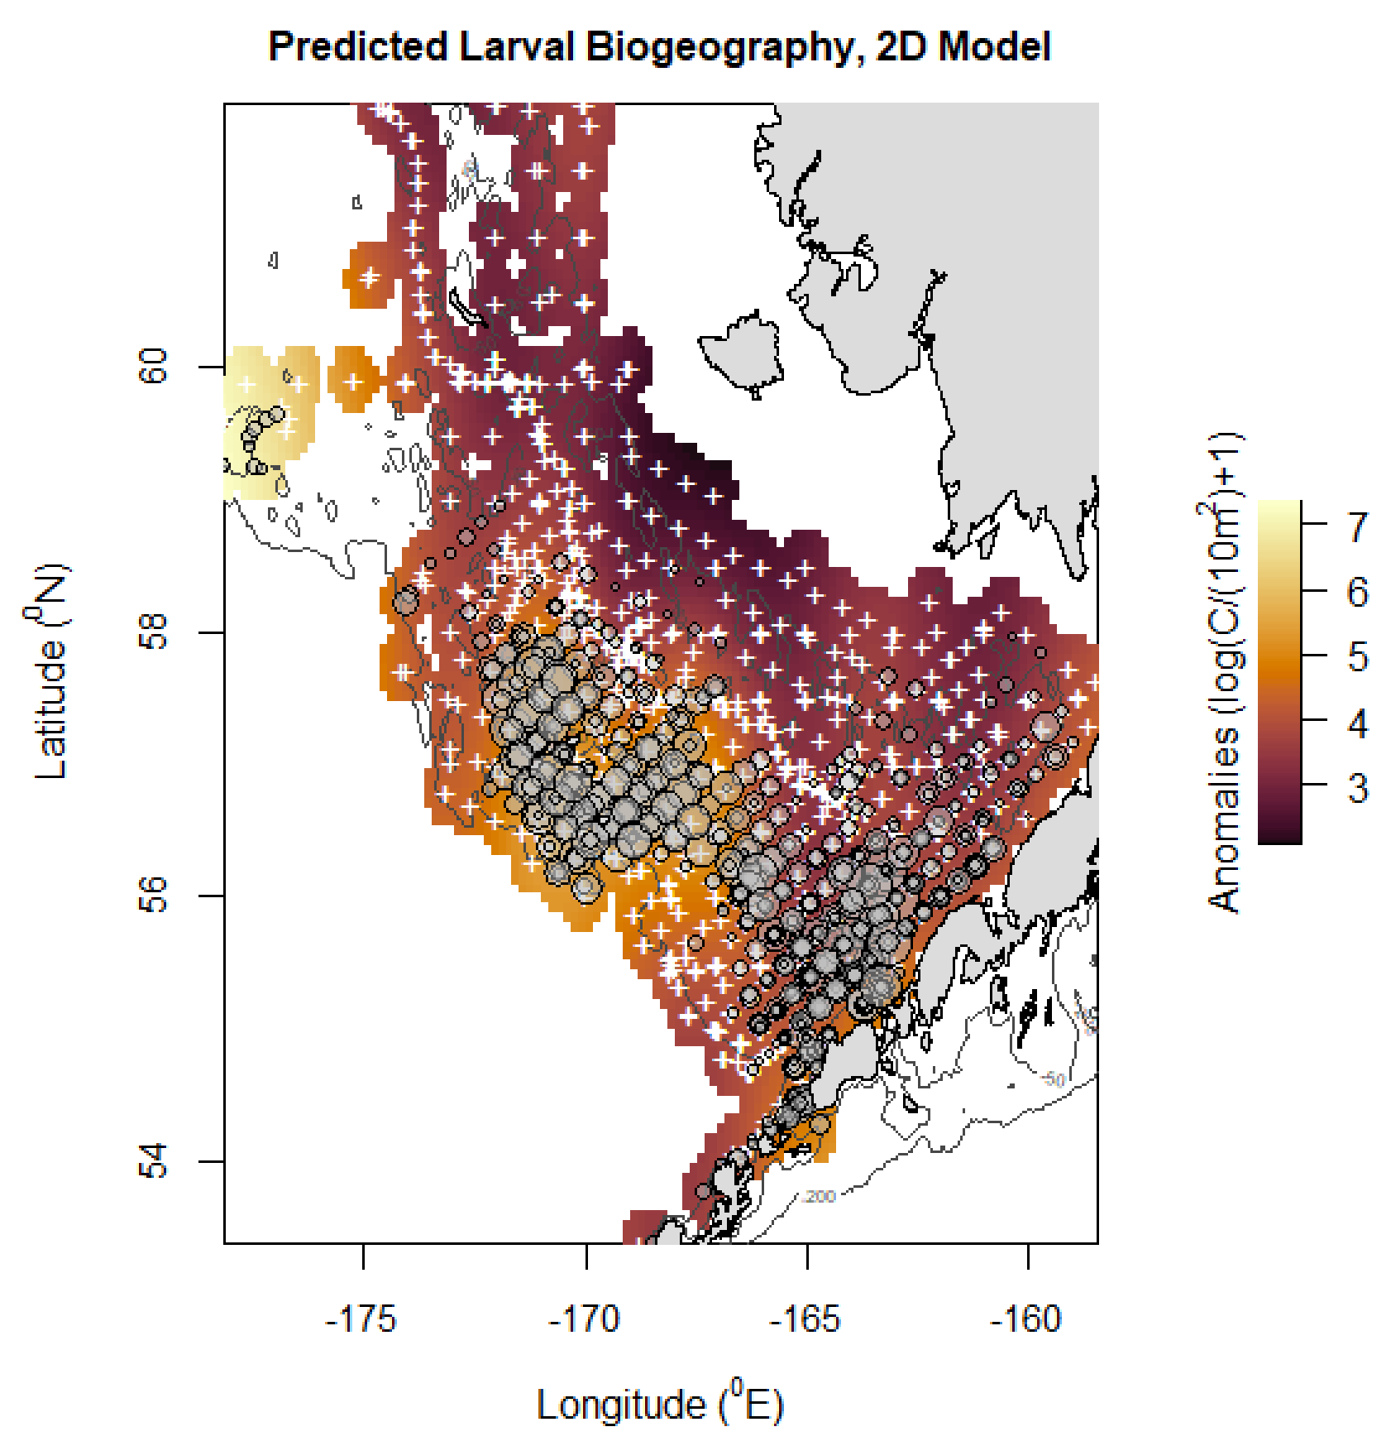
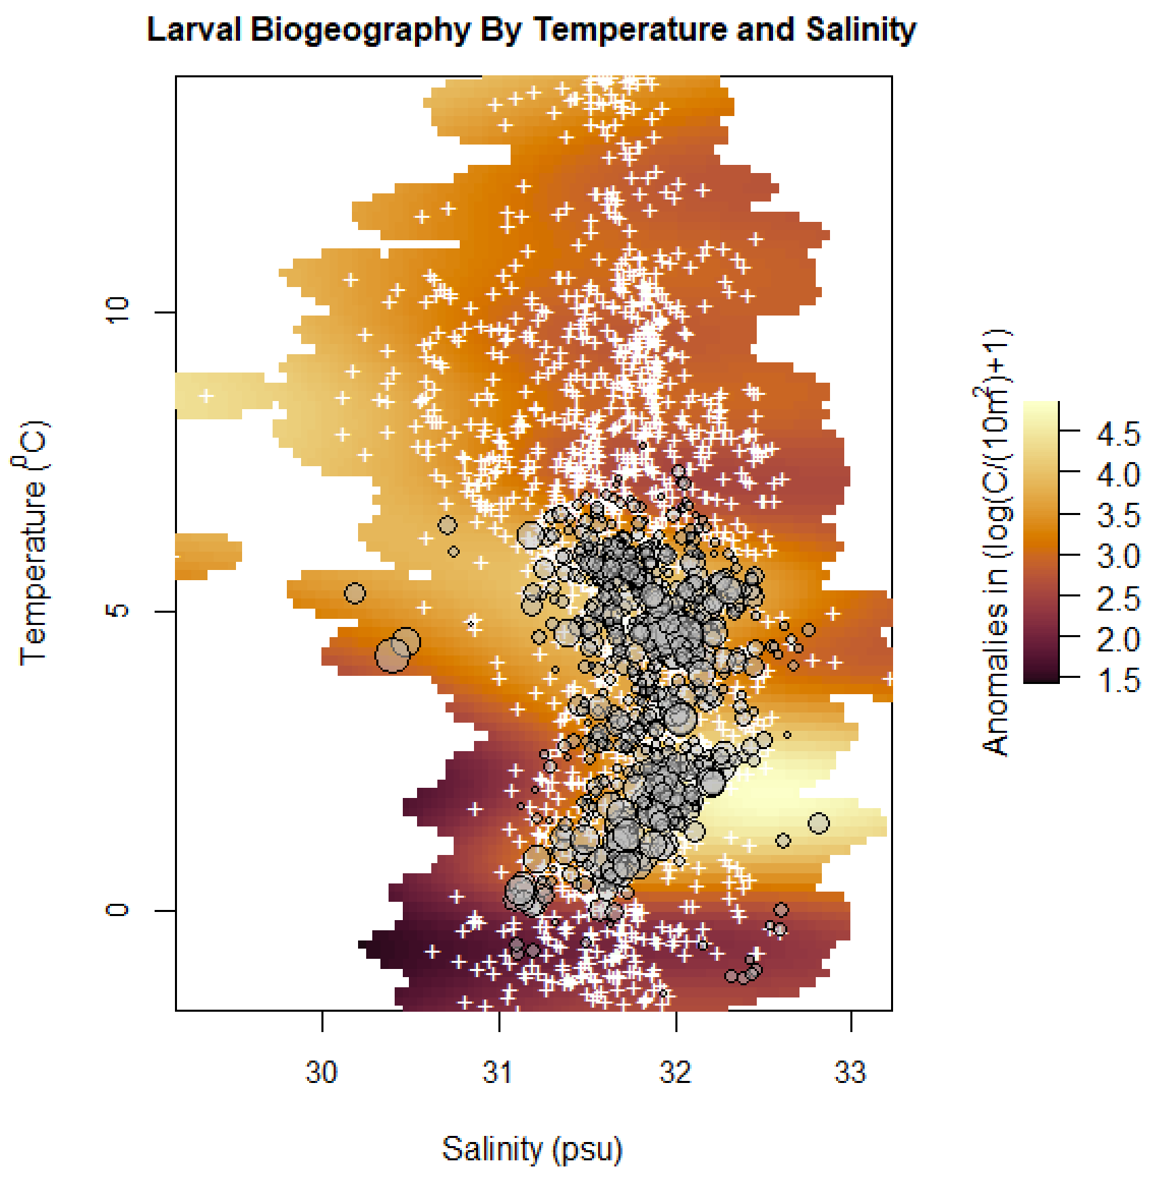
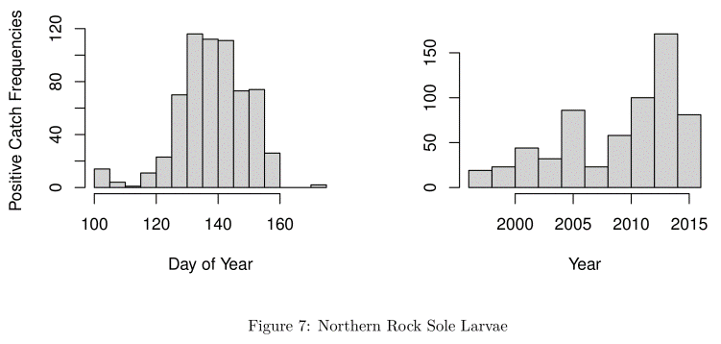
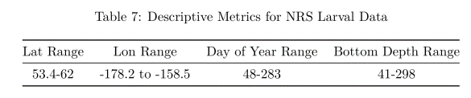
Northern Rock Sole – best model: 2d (69.2%). AIC power (lv.2d/lv.base) = 0.97

Slide 8
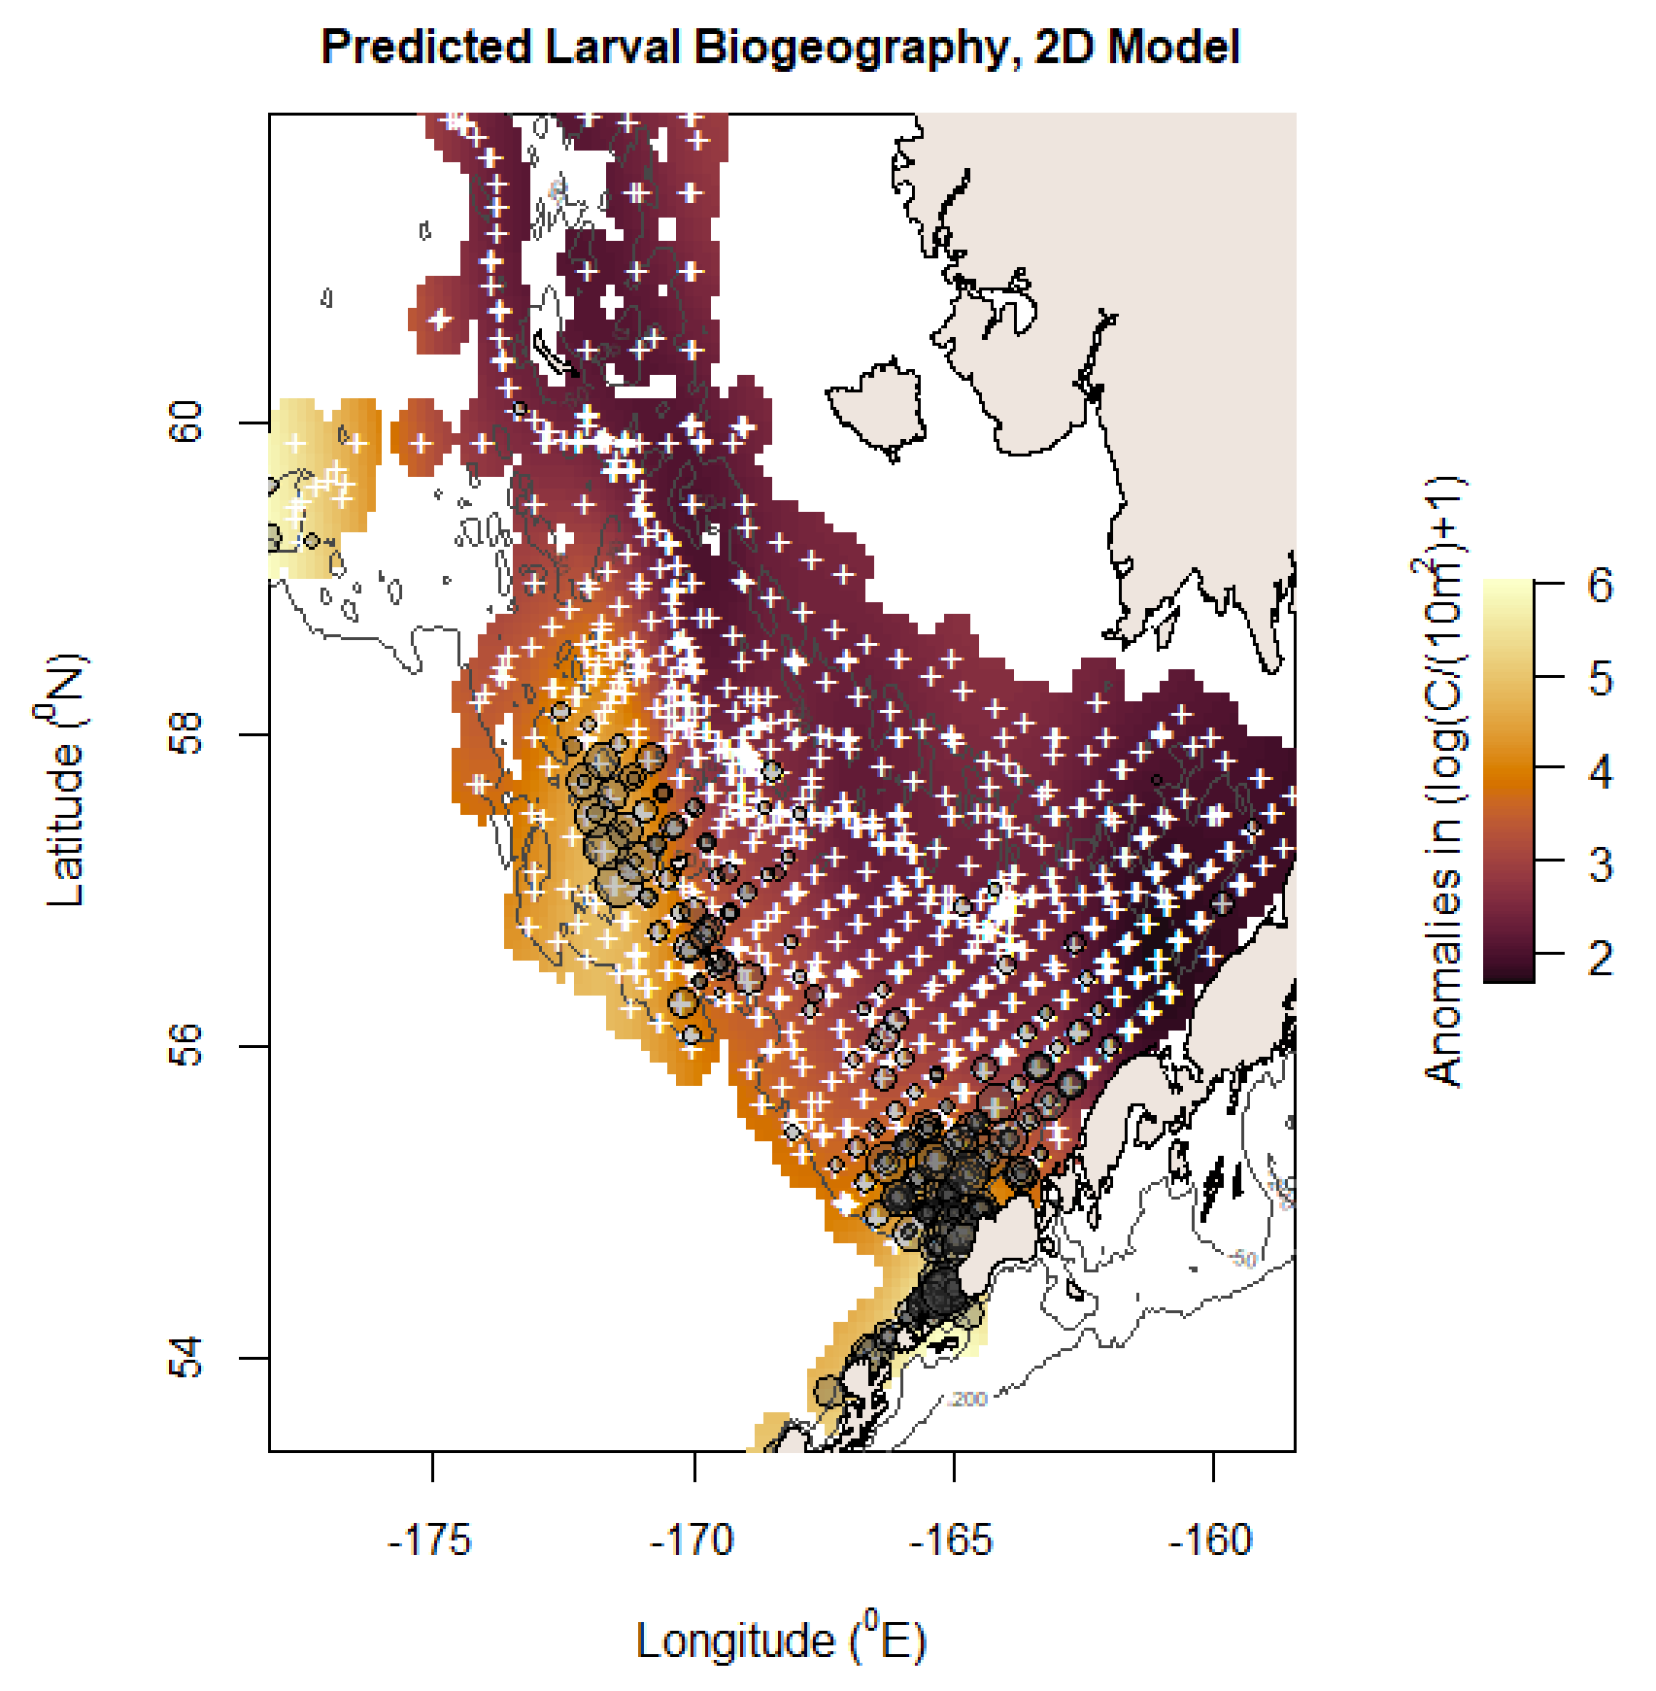
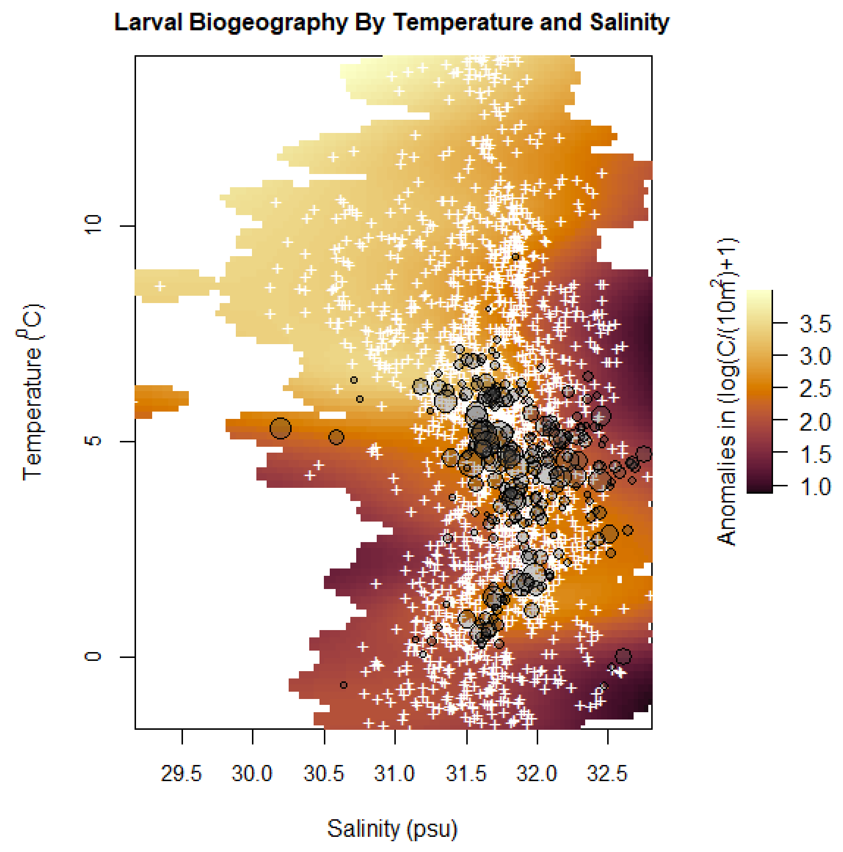
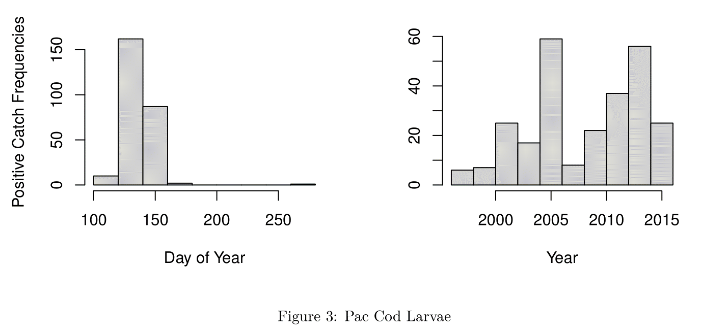
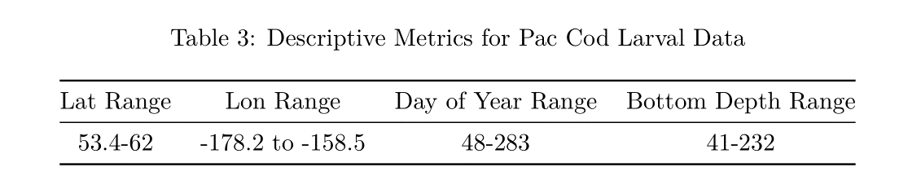
Pacific cod – best model: 2d (72.7%). AIC power (lv.2d/lv.base) = 0.97

Slide 9
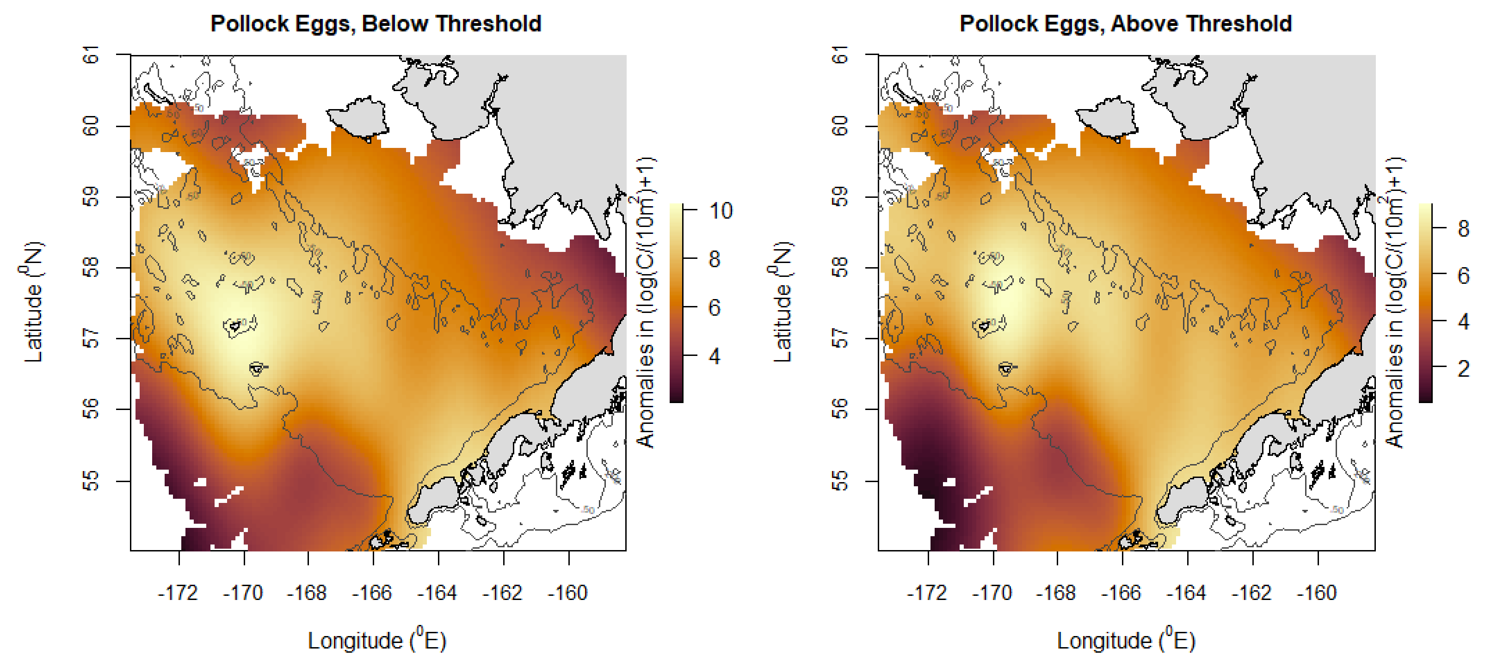
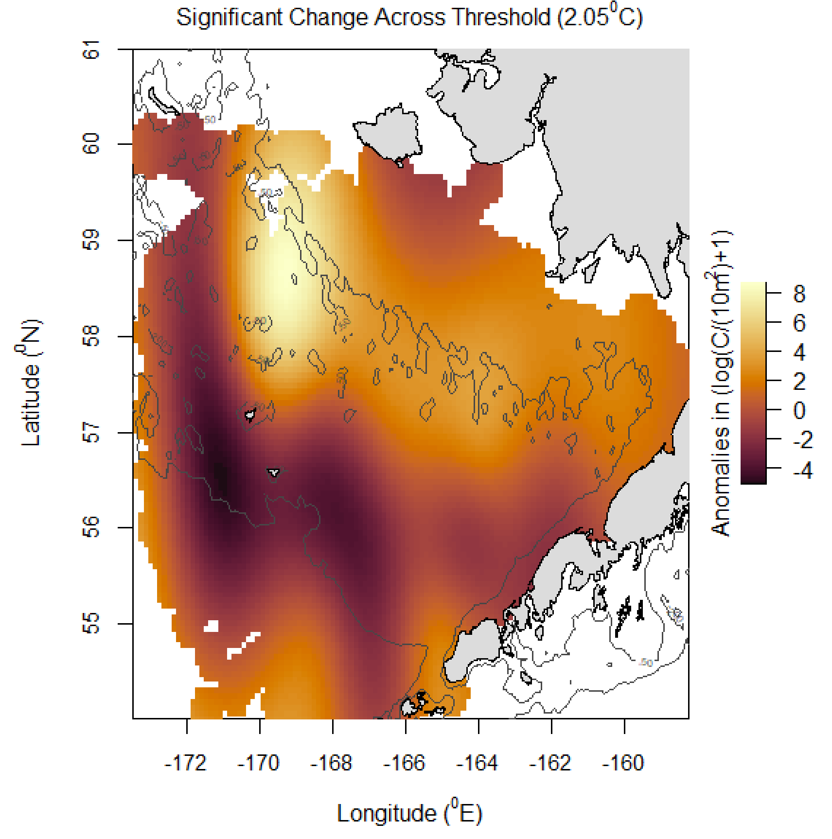
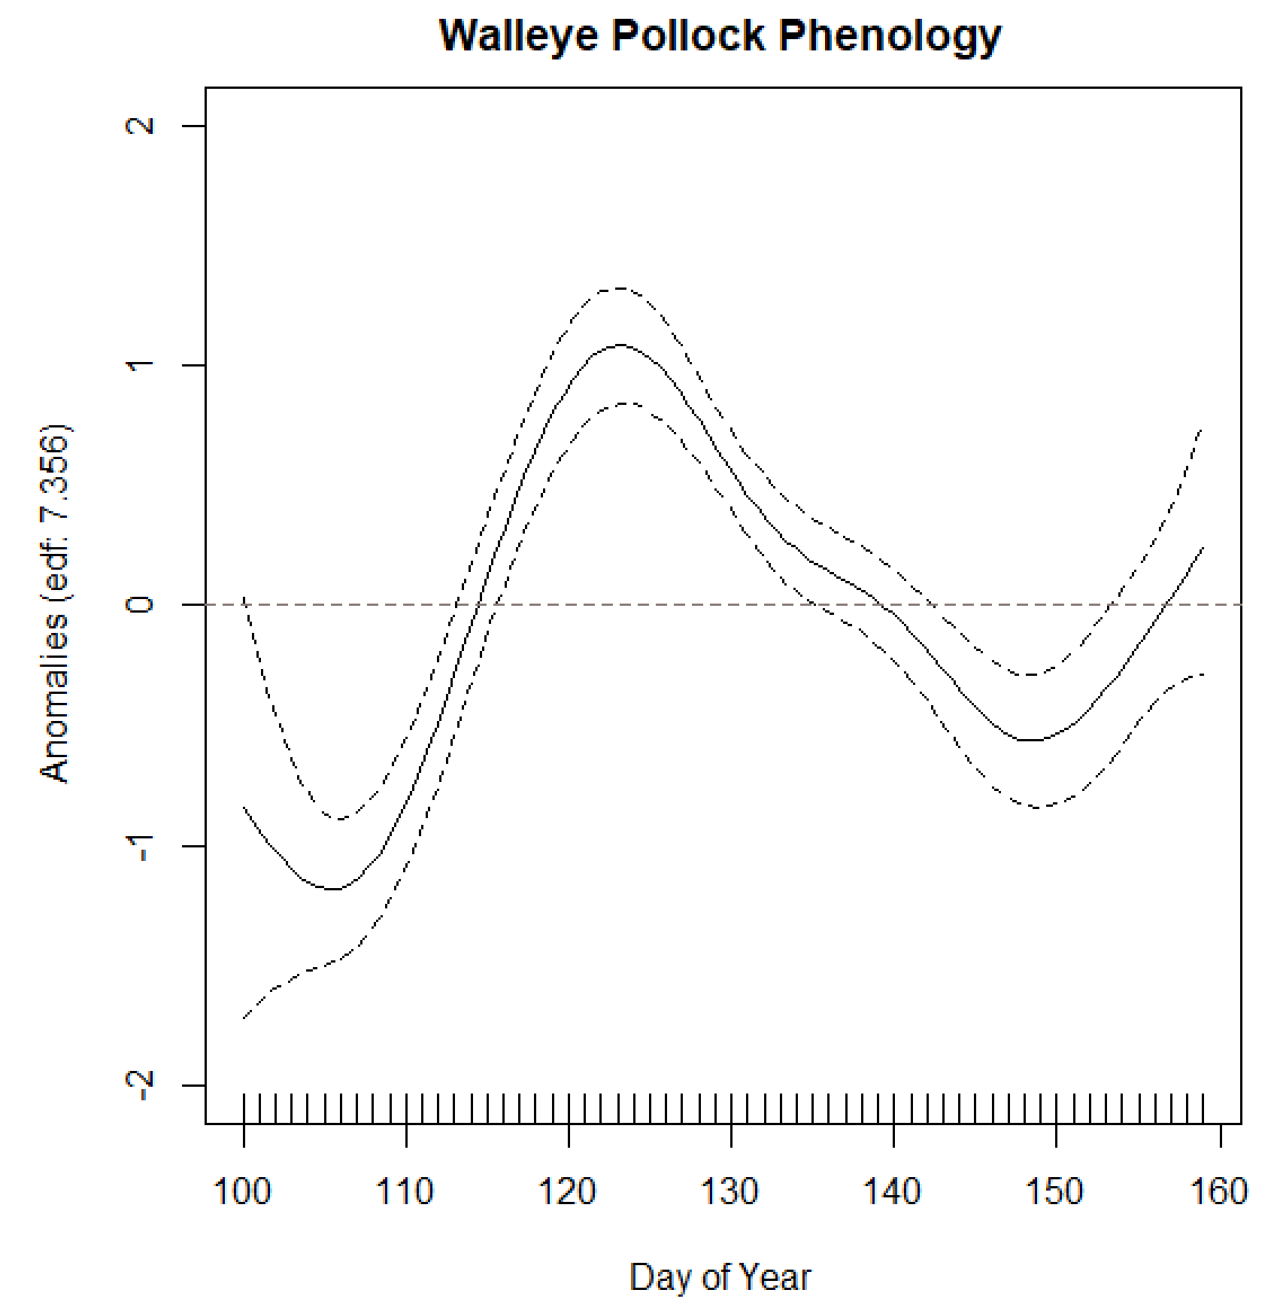
Walleye pollock – best model: threshold geography (59.2%), 2d (69.8%). AIC power (thr.geo/eg.base) = 0.98; AIC power (lv.2d/lv.base) = 0.98

Slide 10
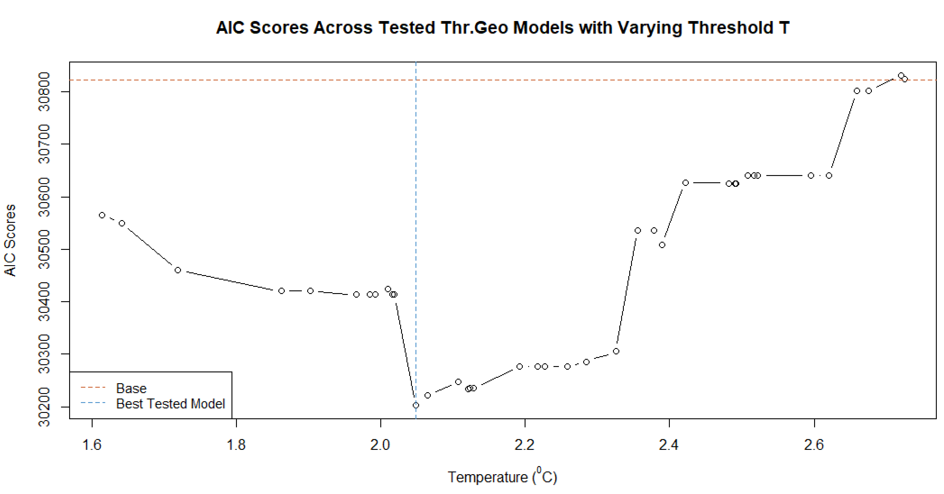
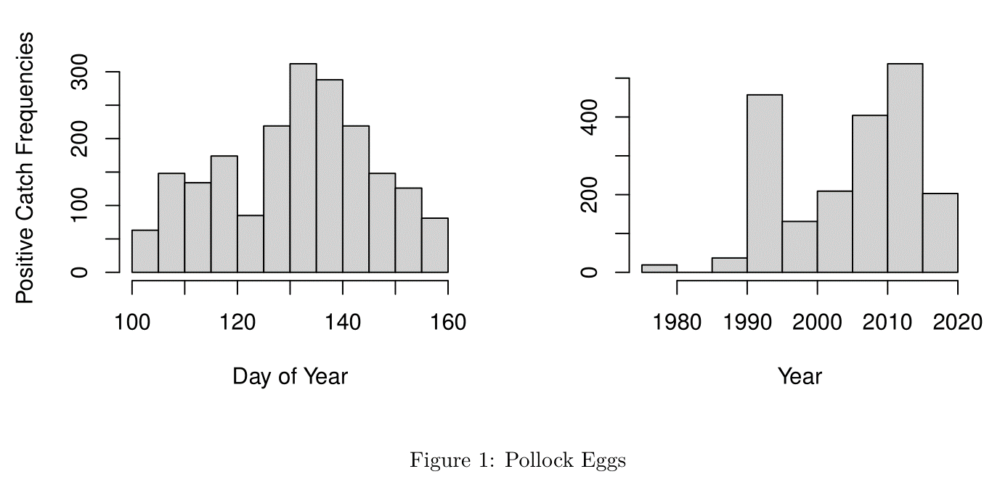
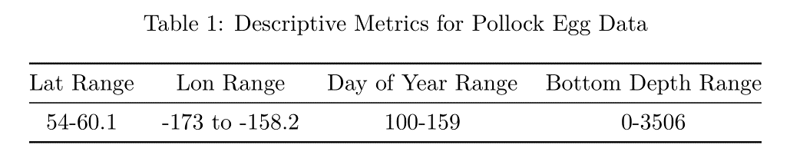
Walleye pollock – best model: threshold geography (59.2%), 2d (69.8%). AIC power (thr.geo/eg.base) = 0.98; AIC power (lv.2d/lv.base) = 0.98

Slide 11
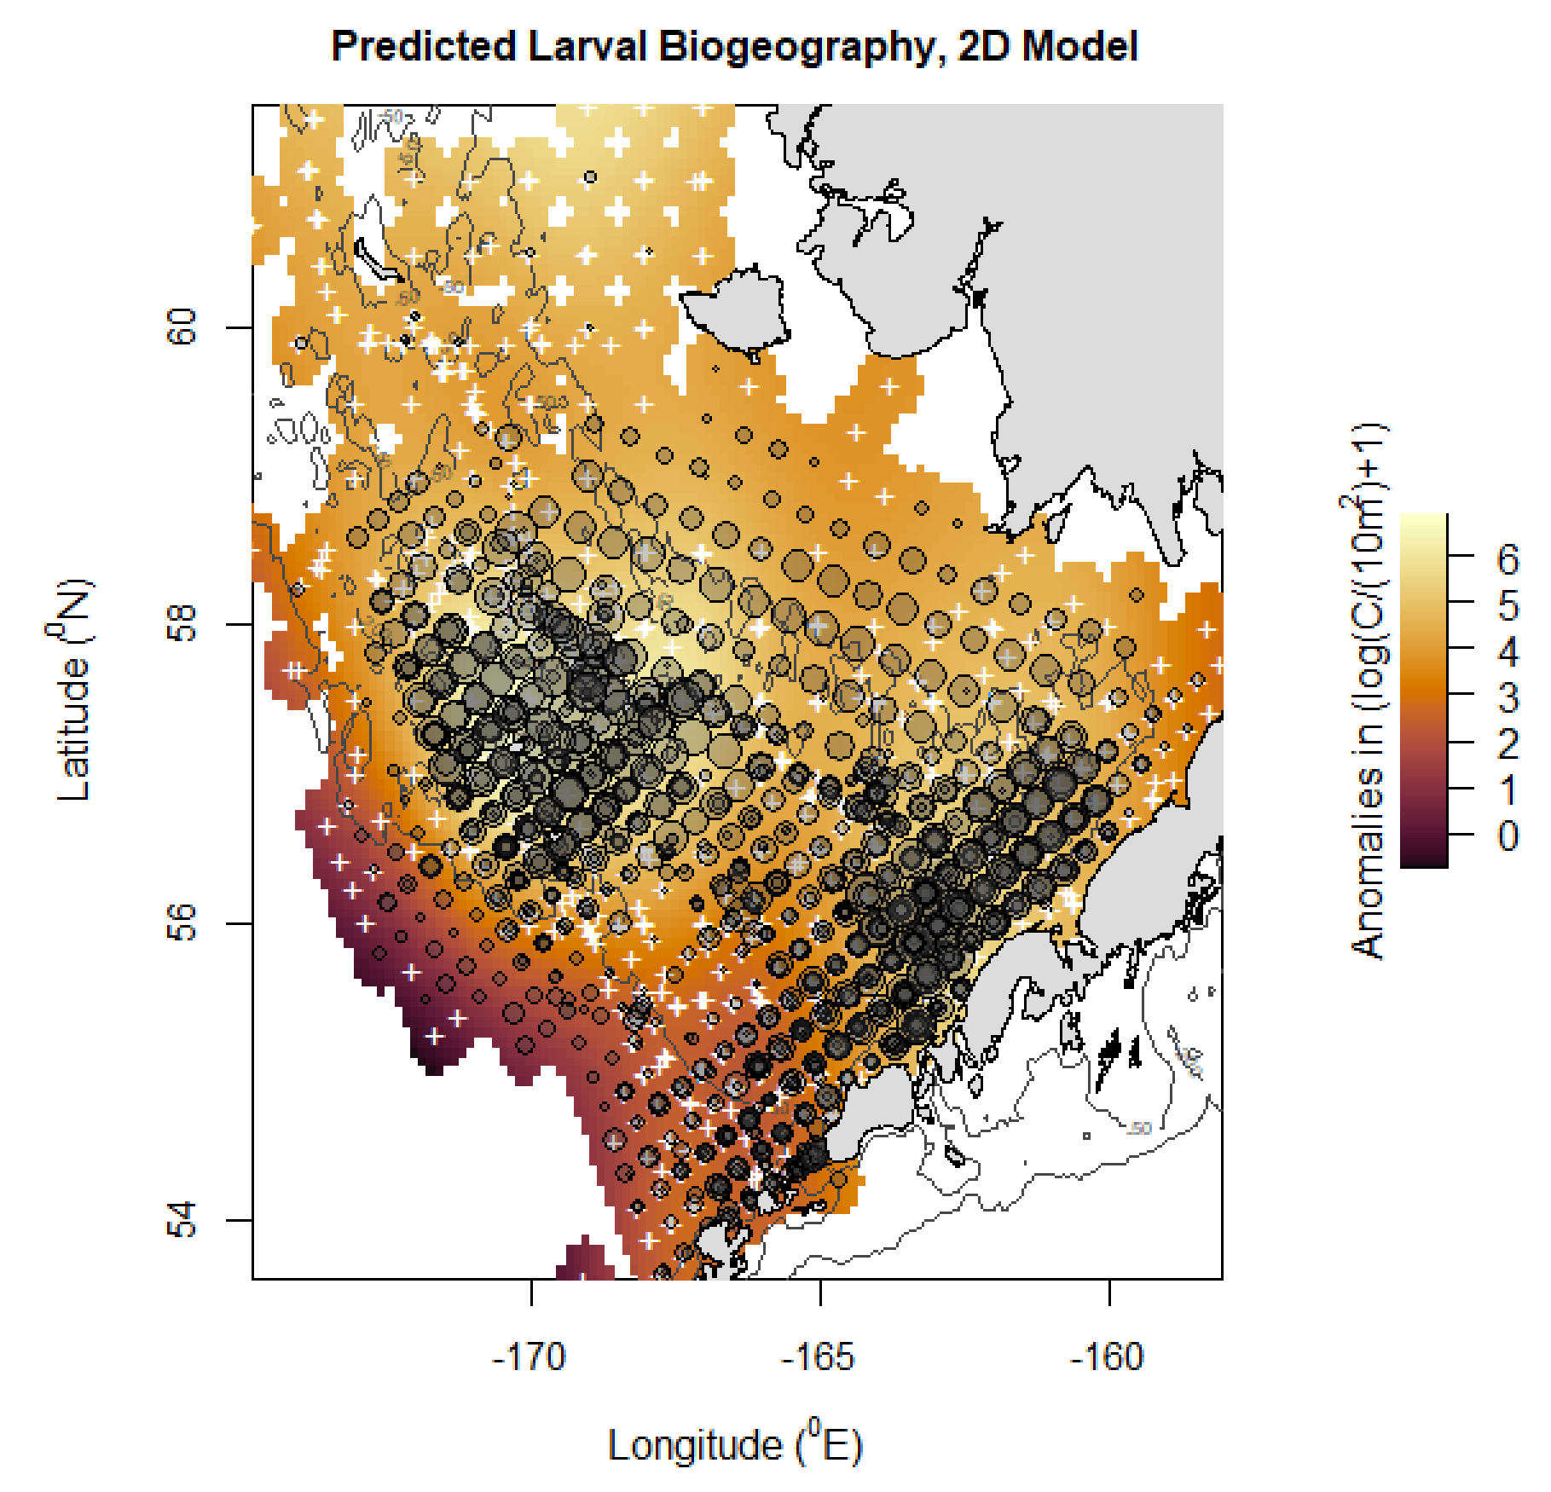
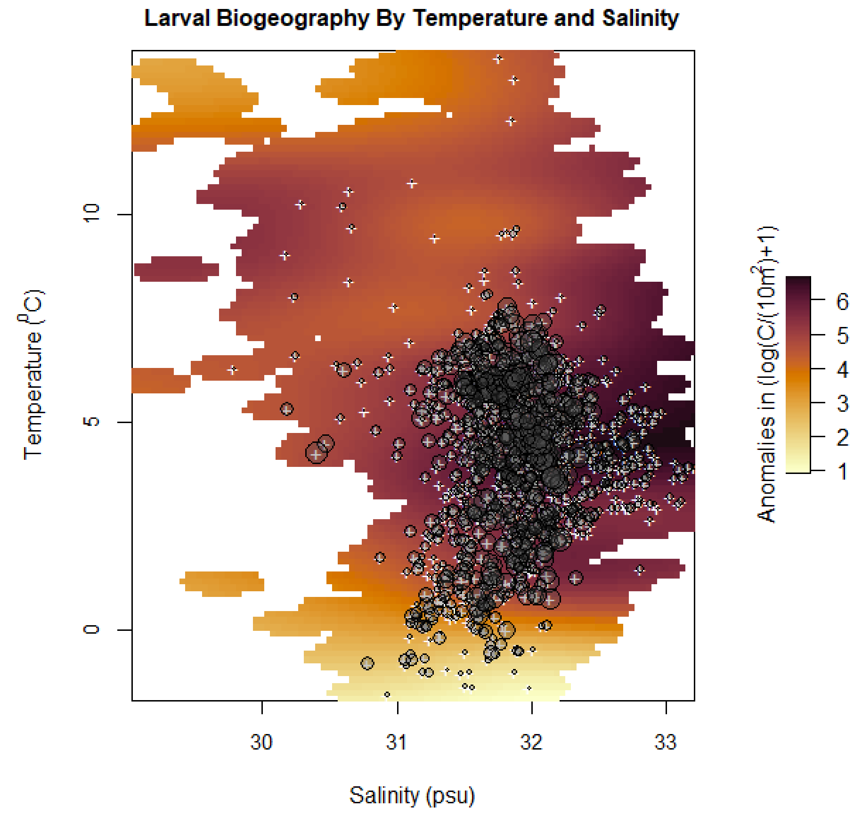
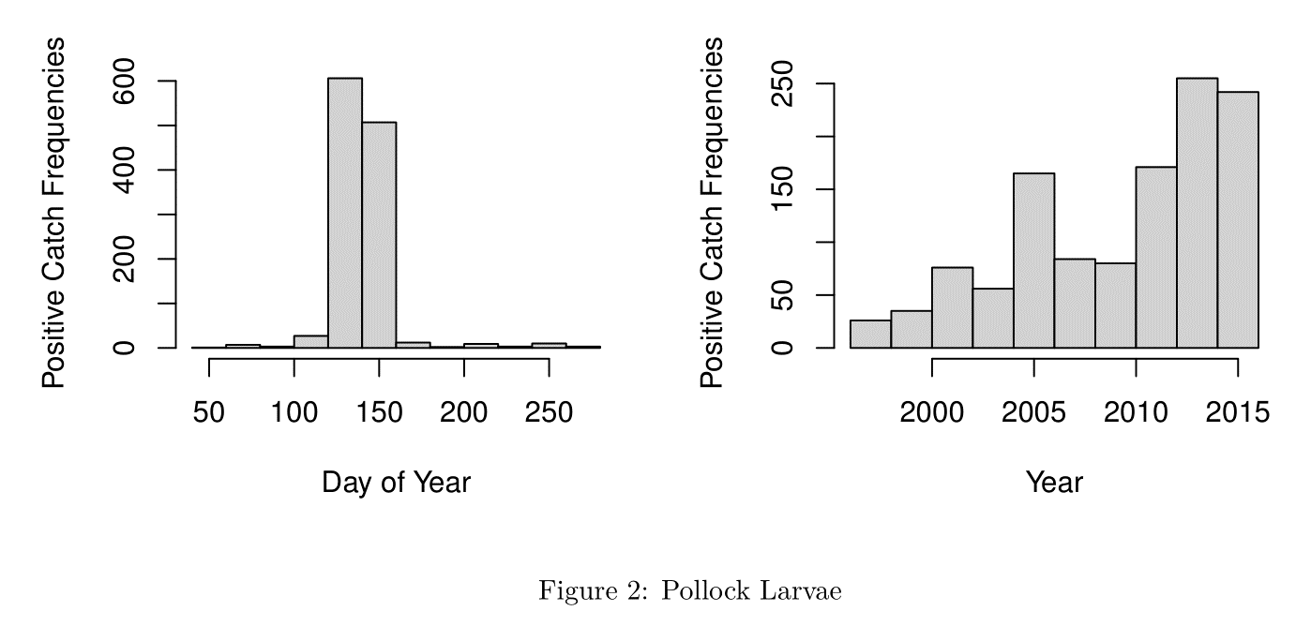
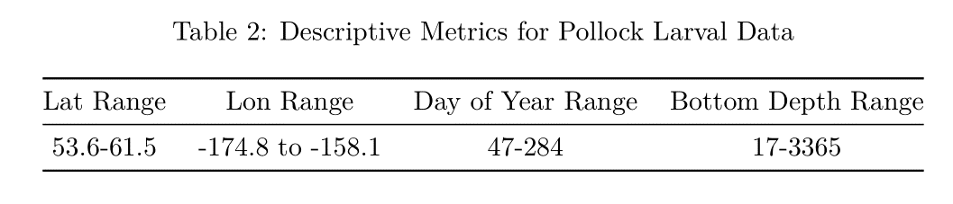
Walleye pollock – best model: threshold geography (59.2%), 2d (69.8%). AIC power (thr.geo/eg.base) = 0.98; AIC power (lv.2d/lv.base) = 0.98

Slide 12
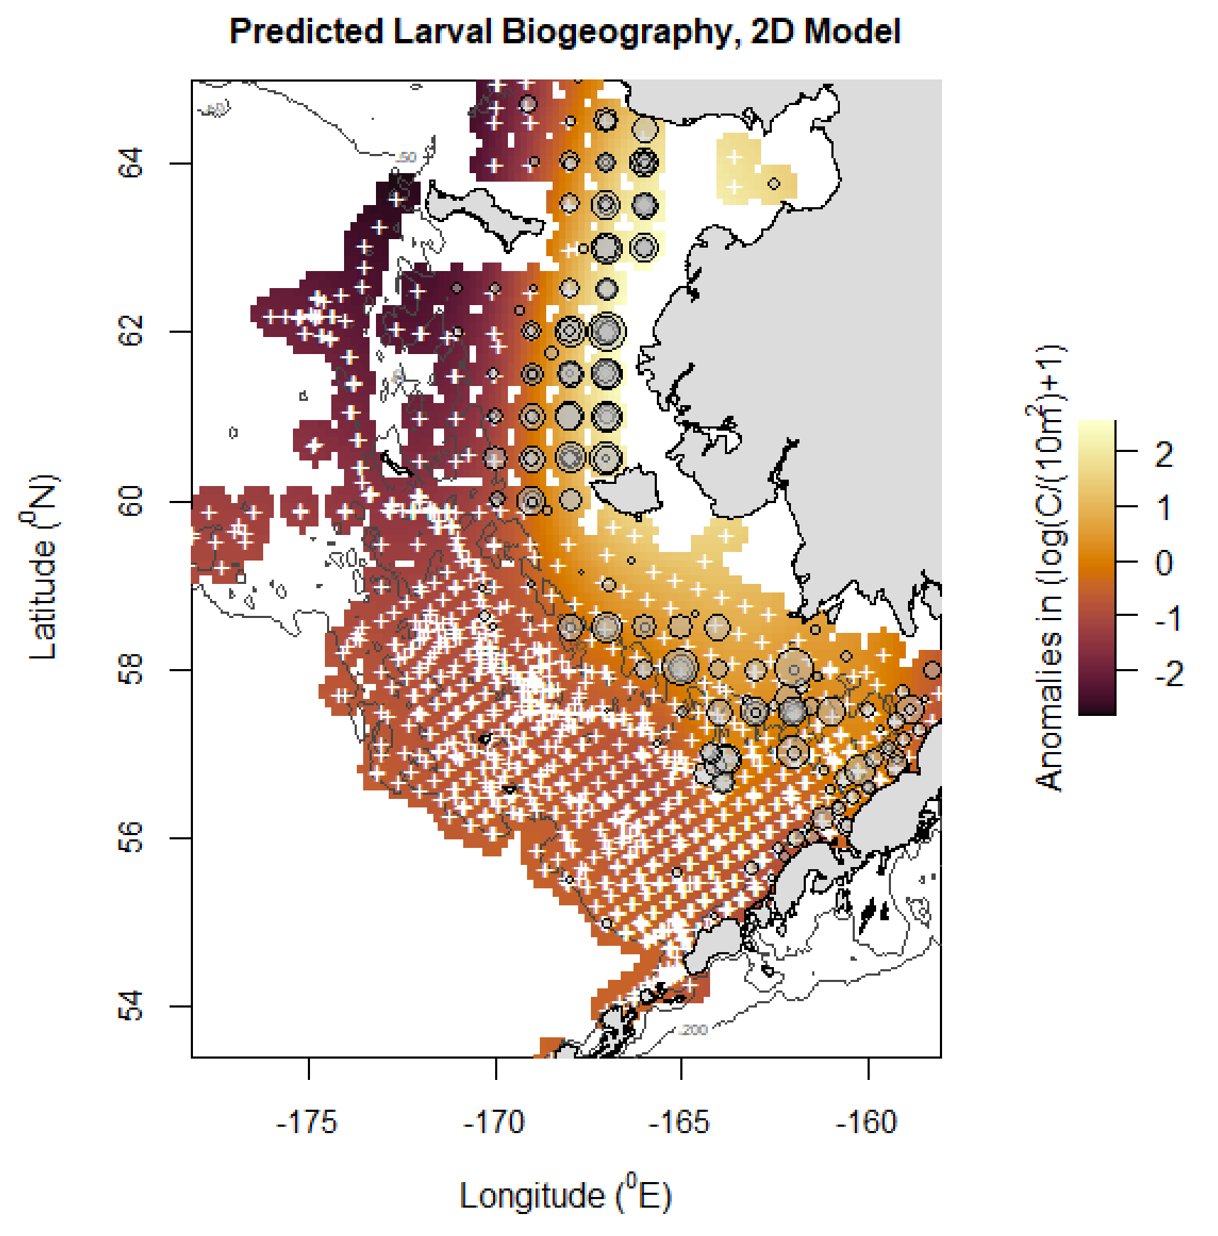
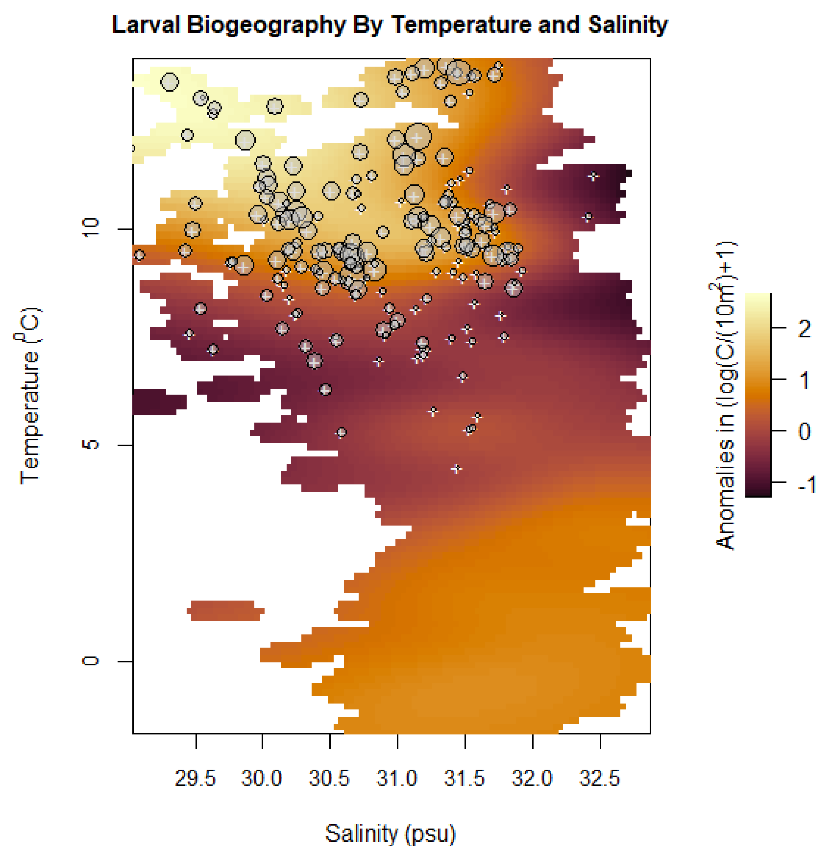
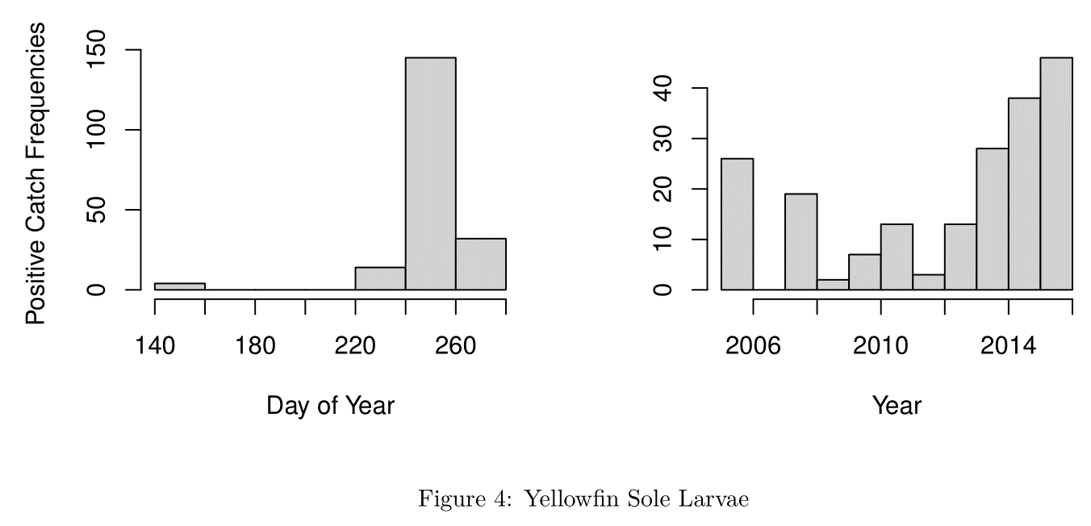
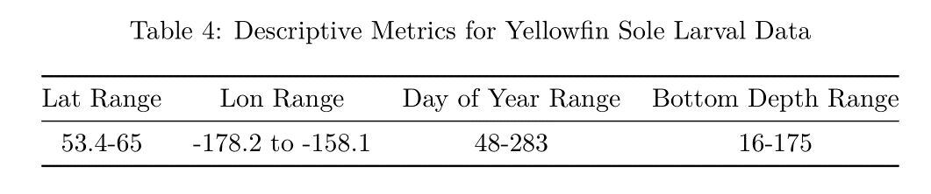
Yellowfin sole - best model: 2d (69.8%). AIC power (lv.2d/lv.base) = 0.93

Slide 13
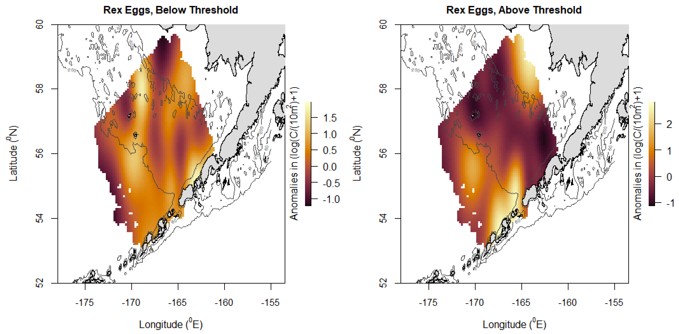
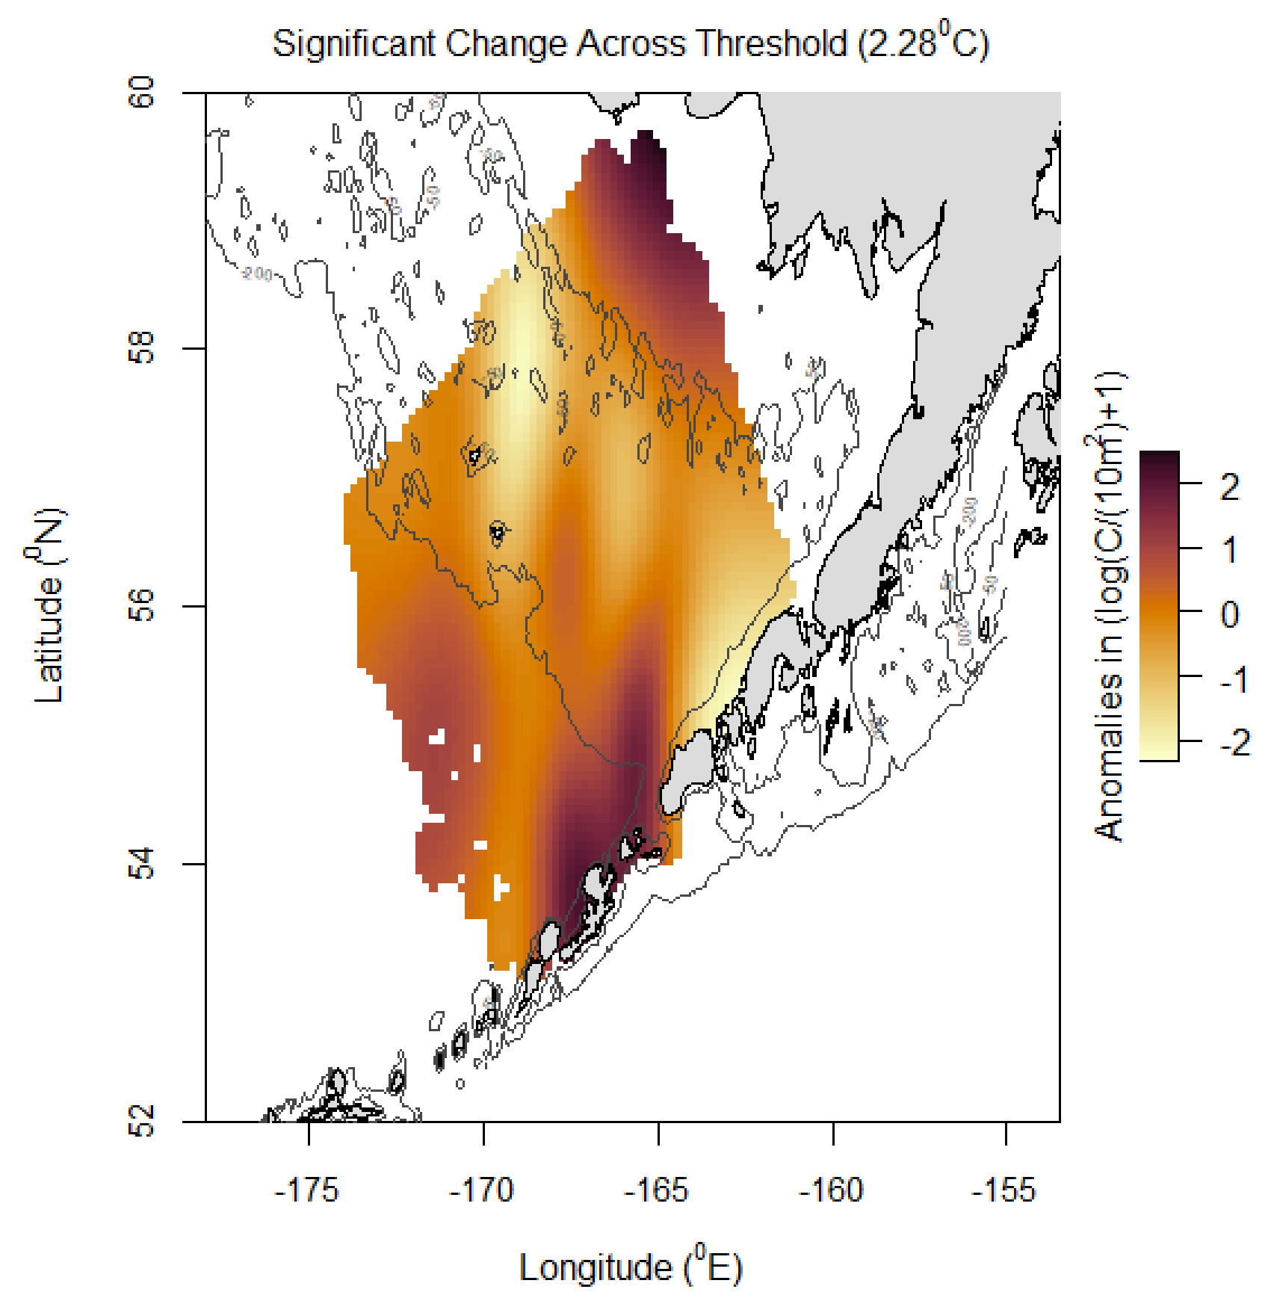
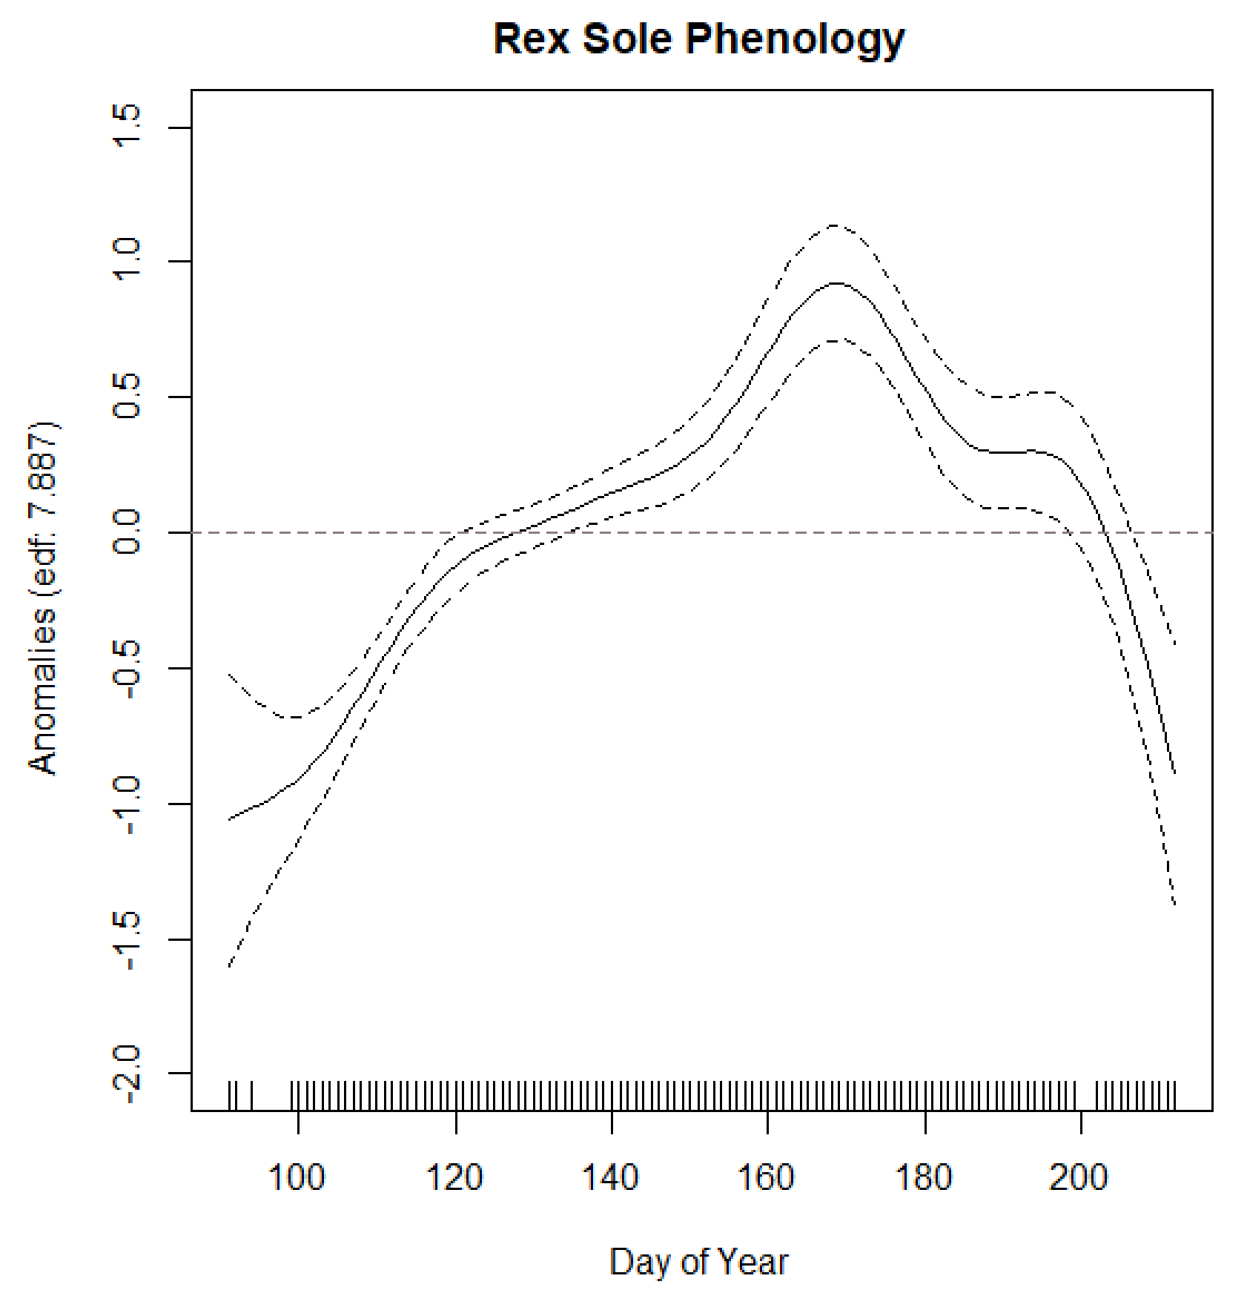
Rex sole – best model: threshold geography (63.2%). AIC power (thr.geo/eg.base) = 0.93.

Slide 14
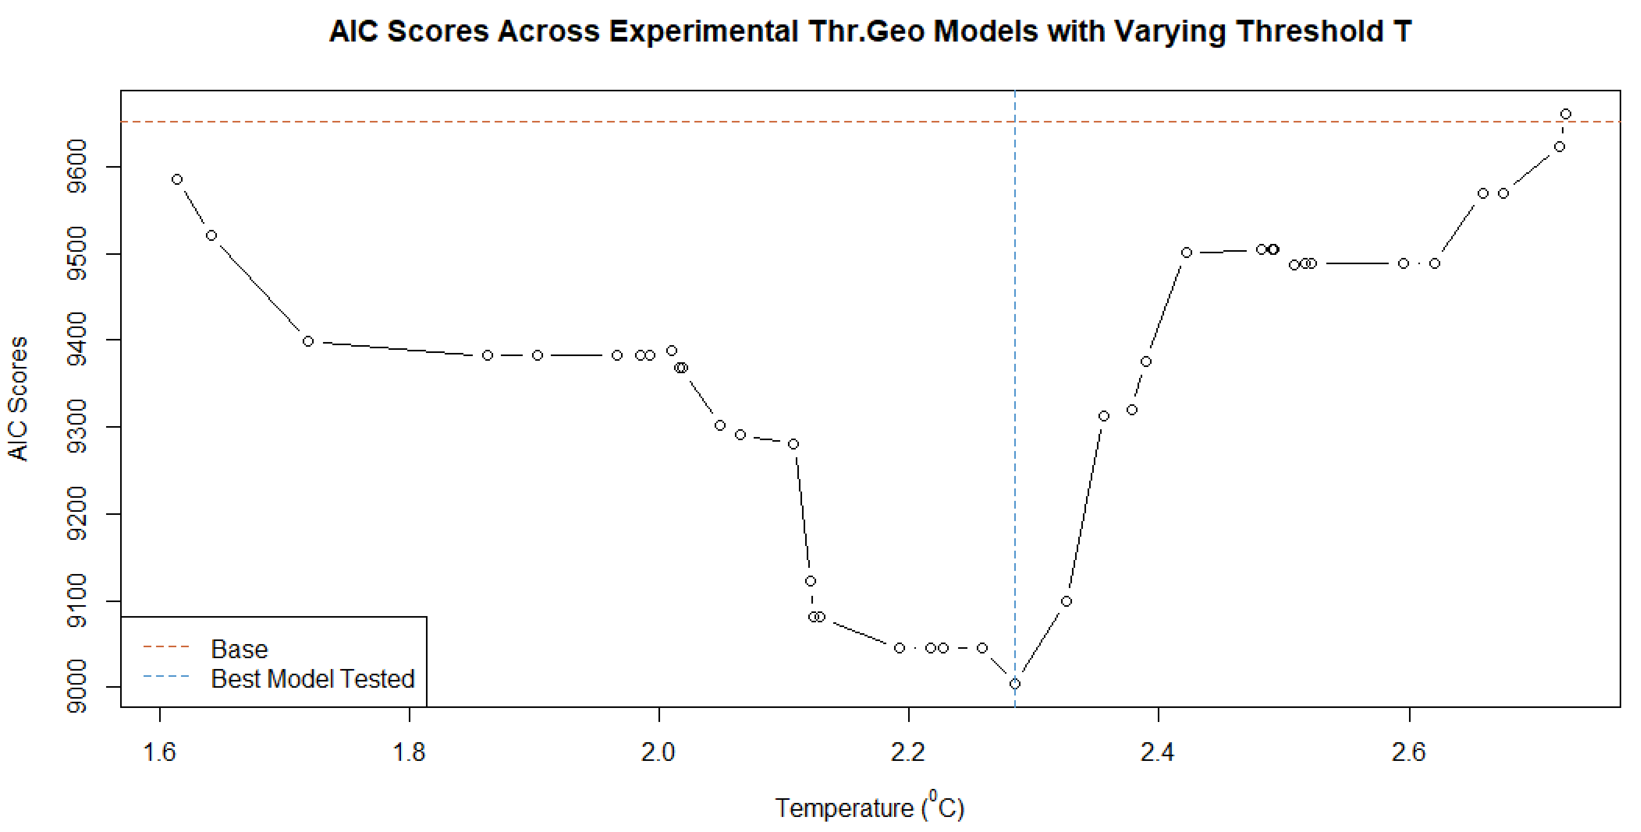
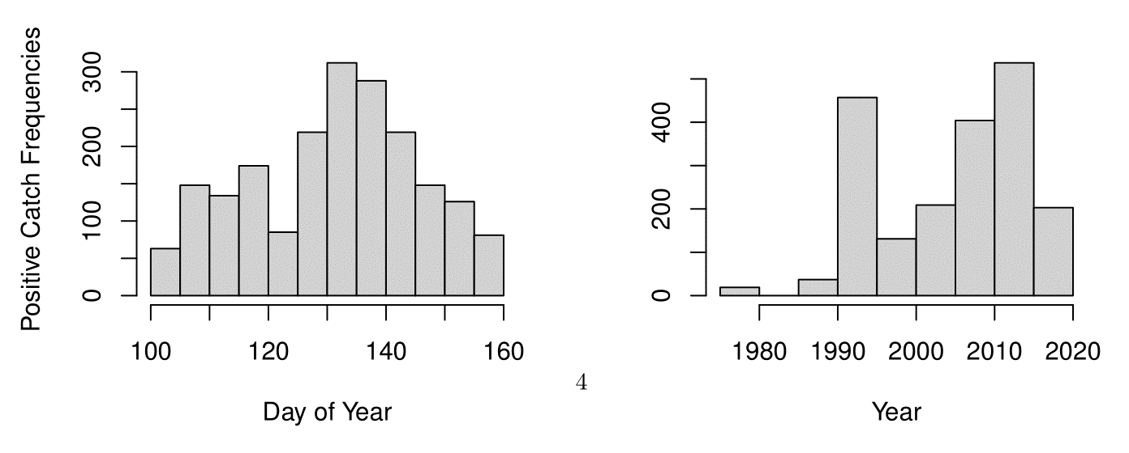
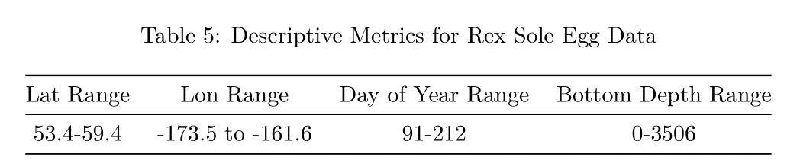
Rex sole – best model: threshold geography (63.2%). AIC power (thr.geo/eg.base) = 0.93.

